Slide 1
REASONING ABILITY

Slide 2
REASONING ABILITY Session – 1 CLOCKS

Slide 3
CLOCKS
Unit of Time
The unit of time in clocks is seconds. A second, the SI unit of time, is defined as the natural periodicity of the radiation of a caesium-133 atom. A duration of 60 seconds is defined as a minute. In clocks, it is also defined as the time taken by the minute hand to move across a minute space.
A duration of 60 minutes is defined as an hour. In clocks, it is also defined as the time taken by the hour hand or short hand to move across five minute spaces or one hour space. A day is also defined as the duration of 24 hours.

Slide 4
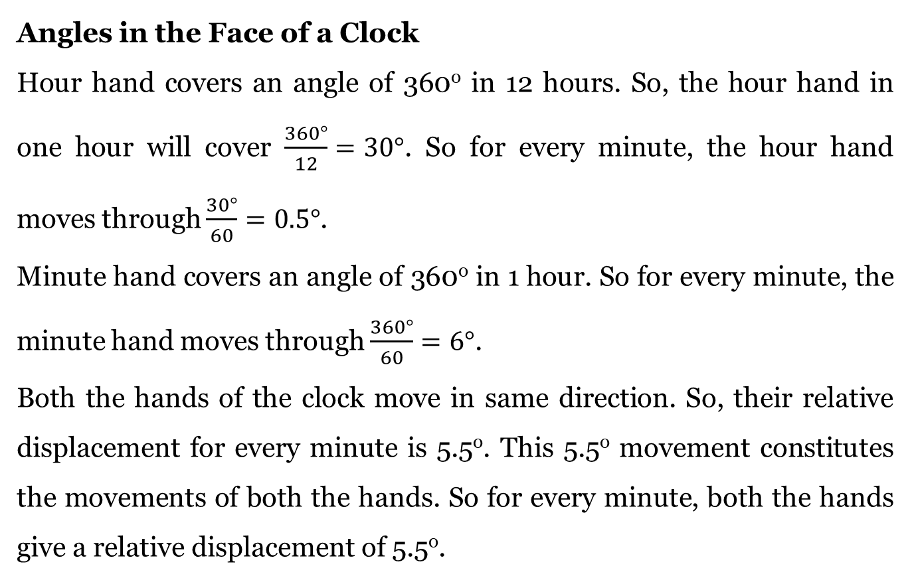
Angles in the Face of a Clock
Hour hand covers an angle of 360º in 12 hours. So, the hour hand in one hour will cover $\frac{360°}{12}=30°$. So for every minute, the hour hand moves through $\frac{30°}{60}=0.5°$.
Minute hand covers an angle of 360º in 1 hour. So for every minute, the minute hand moves through $\frac{360°}{60}=6°$.
Both the hands of the clock move in same direction. So, their relative displacement for every minute is 5.5º. This 5.5º movement constitutes the movements of both the hands. So for every minute, both the hands give a relative displacement of 5.5º.

Slide 5
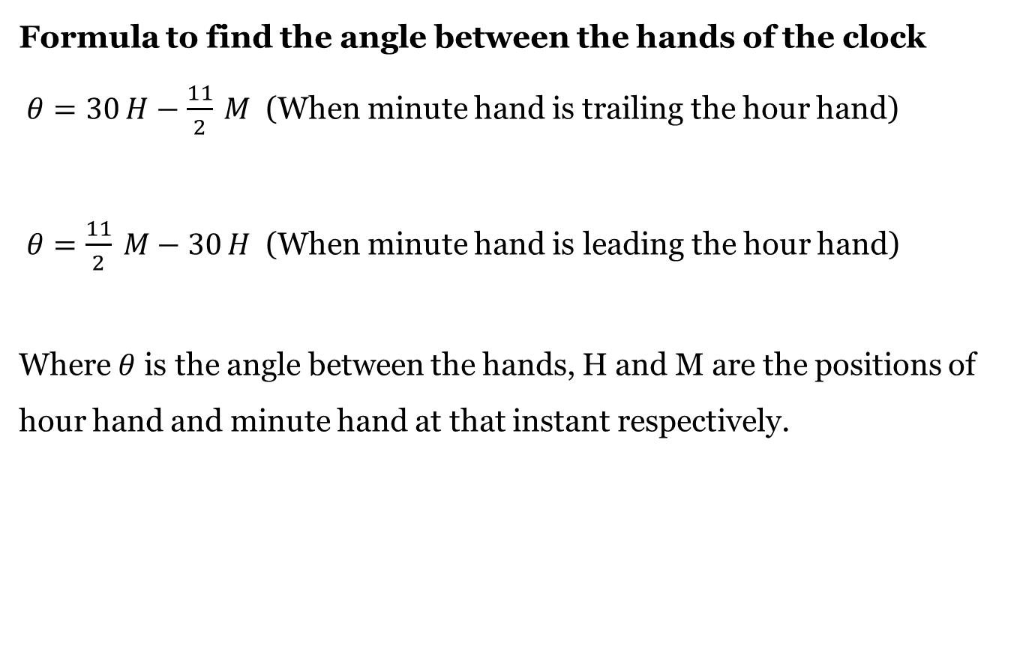
Formula to find the angle between the hands of the clock
$θ=30 H−\frac{11}{2} M$ (When minute hand is trailing the hour hand)
$θ=\frac{11}{2} M−30 H$ (When minute hand is leading the hour hand)
Where $θ$ is the angle between the hands, H and M are the positions of hour hand and minute hand at that instant respectively.

Slide 6
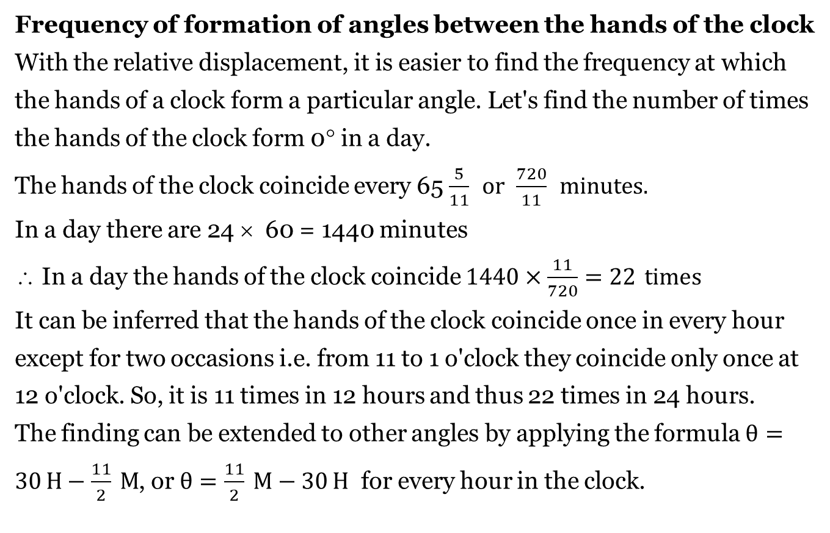
Frequency of formation of angles between the hands of the clock
With the relative displacement, it is easier to find the frequency at which the hands of a clock form a particular angle. Let's find the number of times the hands of the clock form 0° in a day.
The hands of the clock coincide every 65 $\frac{5}{11} or \frac{720}{11} \text{minutes}\text{.}$
In a day there are 24 × 60 = 1440 minutes
∴ In a day the hands of the clock coincide $1440×\frac{11}{720}=22 times$
It can be inferred that the hands of the clock coincide once in every hour except for two occasions i.e. from 11 to 1 o'clock they coincide only once at 12 o'clock. So, it is 11 times in 12 hours and thus 22 times in 24 hours.
The finding can be extended to other angles by applying the formula $θ=30 H−\frac{11}{2} M$, or $θ=\frac{11}{2} M−30 H$ for every hour in the clock.

Slide 7
Angle | Occurrence in a day | Reference time
0º | 22 times | 12 o'clock
30º | 44 times | 11 o'clock and 1 o'clock
60º | 44 times | 10 o'clock and 2 o'clock
90º | 44 times | 9 o'clock and 3 o'clock
120º | 44 times | 8 o'clock and 4 o'clock
150º | 44 times | 7 o'clock and 5 o'clock
180º | 22 times | 6 o'clock

Slide 8
From the table, we find that there are two reference times for all angles except 0° and 180°. As seen already, the angle 30° is formed twice for every hour but occurs only thrice in the following periods of time.
From 10 o'clock to 12 o'clock (Reference time 11 o'clock)
From 12 o'clock to 2 o'clock (Reference time 1 o'clock)
Hence, in 12 hours the no. of times the hands of the clock form 30° is 22. Therefore, in 24 hours the no. of times is 44. Similar approach can be used to conclude the frequency of formation for other angles.

Slide 9
Gain and loss of time in an incorrect clock
A normal clock becomes incorrect when there is a change in the speeds of the hands of the clock. As seen already, duration of a day is measured by the time taken by the hour hand to move across the 12 divisions twice.
So, when the speed of the hands of the clock increases they complete their rotation for a day sooner. Thus, they result in loss of time when actually compared with the duration for a day in a correct clock .
Similarly, when the hands of the clock move slower than usual, they take more time to complete the rotations for a day. Thus, they result in gaining more time for a day when compared with that in a correct clock.

Slide 10
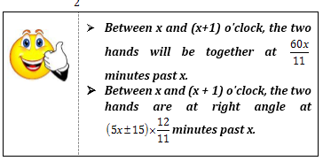

Slide 11
1. Find the angle between the hands of a clock when the time is 5:40.
(a) 80°
(b) 160°
(c) 70°
(d) 120°

Slide 12
2. Find the angle between the minute hand and the hour hand of a clock when the time is 7:20.
(a) 80°
(b) 90°
(c) 100°
(d) 110°

Slide 13
3. The reflex angle between the hands of a clock at 10:25 is
(a) 180°
(b) 162.5°
(c) 165°
(d) 197.5°

Slide 14
4. Find the angle between the hour hand and the minute hand of a clock when the time is 15:25.
(a) 47.5°
(b) 45.5°
(c) 50°
(d) None of these

Slide 15

5. At what time between 5 p.m. and 6 p.m., do the hands of a clock coincide?
(a) $8 hour 29\frac{3}{11} min$
(b) $5 hour 27\frac{3}{11} min$
(c) $9 hour 33\frac{8}{11} min$
(d) None of these

Slide 16

6. The minute hand of a clock is found to cross the hour hand x minutes past three. Find x.
(a) $10\frac{5}{11}$
(b) $15\frac{15}{11}$
(c) $16\frac{4}{11}$
(d) $21\frac{9}{11}$

Slide 17
7. The number of minutes from midnight to now is 9 times the number of minutes from now to noon. What time is it now?
(a) 10.50 a.m.
(b) 10.48 a.m.
(c) 10.40 a.m.
(d) 10.53 a.m.

Slide 18
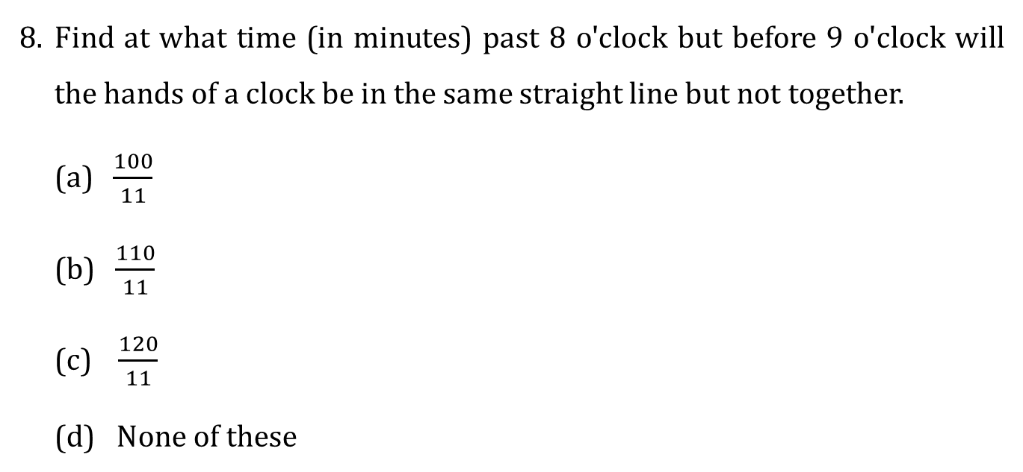
8. Find at what time (in minutes) past 8 o'clock but before 9 o'clock will the hands of a clock be in the same straight line but not together.
(a) $\frac{100}{11}$
(b) $\frac{110}{11}$
(c) $\frac{120}{11}$
(d) $None of these$

Slide 19
9. How many times in a day do the hands of a clock form 60°?
(a) 22
(b) 33
(c) 44
(d) 55
Notes:
9. Ans: [c]
The hands of the clock coincide 22 times a day.
For every coincidence 60 deg will occur 2 times.
So, 44 times it forms 60 deg.

Slide 20
A few times per day, the minute hand of a clock is exactly above (or below) the hour hand. How many times per day does this occur?
(a) 11 times
(b) 24 times
(c) 22 times
(d) 44 times
Notes:
10. Ans: [c]
The question is same as the hour hand and minute hand coincidences. So it will occur 22 times a day.

Slide 21
At how many times between 12 o'clock and 1 o'clock are the minute hand and the hour hand of a clock at an angle of 90 degrees to each other?
(a) 4
(b) 6
(c) 3
(d) 2
Notes:
11. Ans: [d]
The 90 deg between hour and minute hands happens 2 times per coincidence.
Between 12 o’clock to 1 o’clock it happens 2 times.

Slide 22

How much does a watch lose per day, if its hands coincide every 64 minutes?
(a) $32\frac{8}{11}$ min
(b) $36\frac{5}{11}$ min
(c) 90 min
(d) 96 min

Slide 23
How many minutes is it until six o’clock if fifty minutes ago it was four times as many minutes past three o’clock?
(a) 26 minutes
(b) 27 minutes
(c) 30 minutes
(d) None of these
Notes:
13. Ans: [a]
The minutes between 3:00 and 6:00 = 180
As it is given 50 mins ago, the remaining time = 130 mins
Given that the ratio is 4:1, which is 104:26
So it's now 26 minutes to 6.

Slide 24
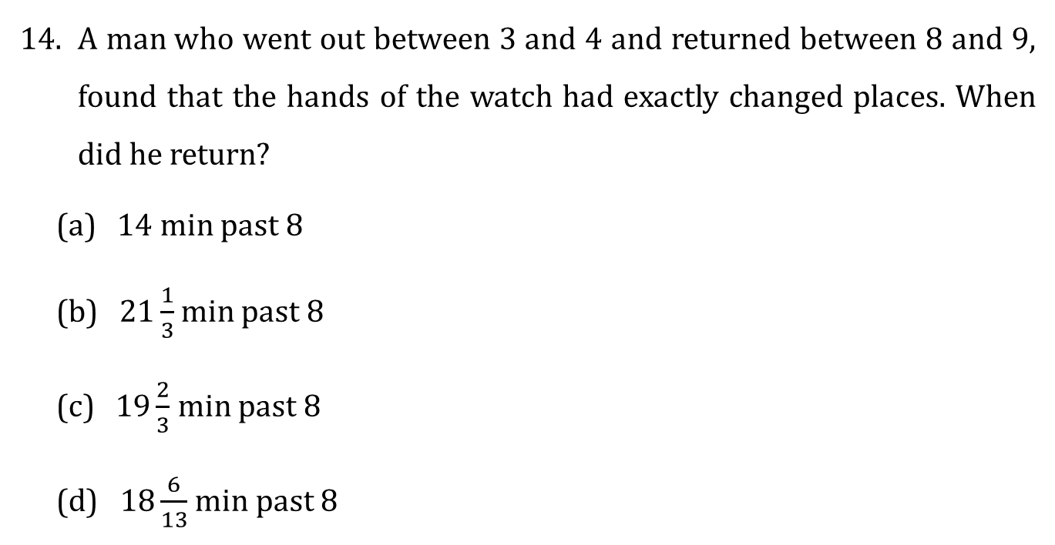
A man who went out between 3 and 4 and returned between 8 and 9, found that the hands of the watch had exactly changed places. When did he return?
(a) 14 min past 8
(b) $21\frac{1}{3}$min past 8
(c) $19\frac{2}{3}$ min past 8
(d) $18\frac{6}{13}$ min past 8

Slide 25
My watch was 8 minutes behind at 8 p.m. on Sunday but it was 7 minutes ahead of time at 8 p.m. on Wednesday. During this period, at which time has this watch shown the correct time?
(a) Tuesday 10.24 a.m.
(b) Wednesday 9.16 p.m.
(c) Tuesday 10.24 p.m.
(d) Wednesday 9.16 a.m.

Slide 26
A friend of mine invented a new clock. It times an entire day in 10 hours, each hour in 100 minutes and each minute in 100 seconds. What normal time is it when it reads 5:41?
(a) 12:59:02
(b) 12:59:01
(c) 11:59:02
(d) None of these
Notes:
16. Ans: [a]
Regular time in sec:
24 hr/day = 86,400 sec/day
New time in sec:
10 hr/day * 100 min/hr * 100 sec/min = 10 * 100 * 100 = 100,000 sec/day
5:41 hrs = 54100 sec
which is 54.1% of the new time
54.1% of regular time = 54.1% * 24 = 12.984 hrs
= 12 hr 59 min 2.4 sec.

Slide 27
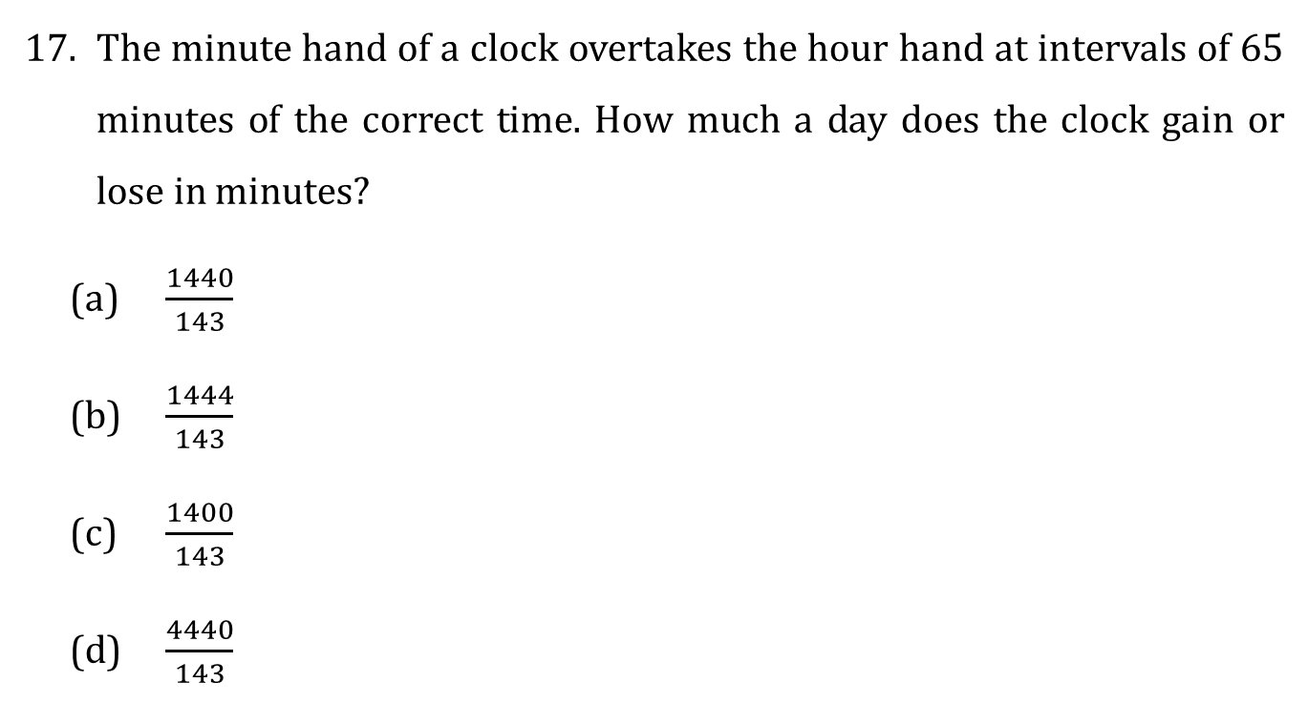
The minute hand of a clock overtakes the hour hand at intervals of 65 minutes of the correct time. How much a day does the clock gain or lose in minutes?
(a) $\frac{1440}{143}$
(b) $\frac{1444}{143}$
(c) $\frac{1400}{143}$
(d) $\frac{4440}{143}$

Slide 28
Between 11 o'clock and 12 o'clock, how often will the difference between the minute and hour hands of a clock have an integral number of minutes?
(a) 4
(b) 6
(c) 3
(d) 5
Notes:
18. Ans: [d]
At 11 o'clock, the hour hand is 5 spaces apart from the minute hand.
During the next 60 minutes, i.e. between 11 o'clock and 12 o'clock, the hour hand will move five spaces [integral values as denoted by the 56 minute, 57 minute,58 minute, 59 minute and 60 minute positions].
For each of these 5 positions, the minute hand will be at the 12th minute, 24th minute, 36th minute, 48th minute and 60th minute positions.
Hence there will be 5 integral minutes between the positions of the hour hand and the minute hand between 11 & 12 o'clock.

Slide 29
A clock loses 1% time during the first week and then gains 2% time during the next one week. If the clock was set right at 12 noon on a Sunday, what will be the time shown by the clock exactly after 14 days from the time it was set right?
(a) 1:40:48 p.m.
(b) 1:40:28 p.m.
(c) 1:40:46 p.m.
(d) 1:40:26 p.m.
Notes:
19. Ans: [a]
In the first week, the clock loses 1% of total time.
Total hrs = 7 * 24 = 168 hrs
1% of 168 hrs = 1.68 hrs
In the second week, the clocks gains 2% of total time.
Total hrs = 7 * 24 = 168 hrs
2% of 168 hrs = 3.36 hrs
Total net gain = 3.36 – 1.68 = 1.68 hrs
So the clock will show a time which is 1.68 hours more than 12 noon two weeks from the time it was set right.
1.68 hours = 1 hour and 40.8 minutes = 1 hour + 40 minutes + 48 seconds
= 1:40:48 p.m.

Slide 30
A clock is set right at 8 a.m. The clock gains 10 minutes in 24 hours. What will be the true time when the clock indicates 1 p.m. on the following day?
(a) 48 min past 12
(b) 48 min past 11
(c) 45 min past 12
(d) 45 min past 11

Slide 31
End of Session - 1 Thank You…

Slide 32
Session – 2 CALENDARS

Slide 33
CALENDARS
Leap Year
Leap Years are needed to keep our modern day Gregorian calendar in alignment with the Earth's revolutions around the sun. It takes the Earth approximately 365.242199 days – or 365 days, 5 hours, 48 minutes and 46 seconds – to circle once around the Sun. This is called a tropical year.
However, the Gregorian calendar has only 365 days in a year, so if we didn't add a day on February 29 nearly every 4 years, we would lose almost six hours off our calendar every year. After only 100 years, our calendar would be off by approximately 24 days!

Slide 34
Which Years are Leap Years?
In the Gregorian calendar 3 criteria must be taken into account to identify leap years:
The year is evenly divisible by 4;
If the year can be evenly divided by 100, it is NOT a leap year, unless the year is also evenly divisible by 400. Then it is a leap year.
This means 2000 and 2400 are leap years but 1800, 1900, 2100, 2200, 2300 and 2500 are NOT leap years.
REASON: Every ordinary year, 0.25 days short of 10 minutes and 48 seconds is carried forward. This adds to exactly 259200 seconds i.e. 3 days for every 400 years and hence these three days are reduced one by one for every 100 years with no reduction in the 400th year, which is therefore a leap year. That’s the reason for most of the centuries not being leap years.

Slide 35
So every year which is exactly divisible by 4 is a leap year, except centuries.
E.g.: 1968, 1972, 1984, 1988 and so on are examples of Leap Years. 1986, 1990, 1994, 1998, and so on are examples of non-leap years.
However, centuries which are divisible by 400 are leap years.
E.g.: 400, 800, 1200 are leap years but 100, 200, 300, 500, 600 are not leap years. Last day of a century cannot be Tuesday, Thursday or Saturday.
First day of a century must be Monday, Tuesday, Thursday or Saturday.

Slide 36
The days more than the complete number of weeks in a given period are called odd days.
An ordinary year has 365 days = 52 weeks and 1 odd day
A leap year has 366 days = 52 weeks and 2 odd days
Century (100 years) = 76 ordinary years + 24 leap years
Which means…
100 years = 76 ordinary years + 24 leap years
= 76 odd days + 24 × 2 odd days
= 124 odd days
= 17 weeks + 5 days
So, 100 years have 5 odd days.
200 years have 3 odd days.
300 years have 1 odd day.
400 years have 0 odd days.

Slide 37
Working Rules:
I. Finding the day of the week on a particular date when reference day is given.
Step 1: Find the net number of odd days for the period between the reference day and the given date (exclude the reference day but count the given date for counting the number of net odd days).
Step 2: The day of the week on the particular date is equal to the number of net odd days ahead of the reference day (if the reference day was before this date) but behind the reference day (if this date was behind the reference day).

Slide 38
II. Finding the day of the week on a particular date when no reference day is given.
To find out the day, we have to find out the number of odd days by the following 4 steps:
1. Number of odd days in the past century.
2. Number of odd days in the past year.
3. Number of odd days in the continuing year month-wise.
4. Number of odd days in the continuing month till the exact day.

Slide 39
III. We consider the first date as 1.1.1. It has only one odd day, hence it is Monday.
IV. In an ordinary year (Jan, Oct), (Feb, March, Nov), (April, July), (Sep, Dec) are pairs of months that start with the same day.
V. The first day and the last day of an ordinary year are always the same. The last day will always be the next day of its first day in a leap year.

Slide 40
1. Find the day of the week on 16th July 1776.
(a) Monday
(b) Tuesday
(c) Wednesday
(d) Thursday

Slide 41
2. What was the day of the week on 17th June 1998?
(a) Monday
(b) Tuesday
(c) Wednesday
(d) Thursday
Notes:
2. Ans: [c]
Calculating the odd days
1600 300 98 June 17
0 1 2 4 3 $→$ 3
Hence answer is Wednesday.

Slide 42
3. What was the day of the week on 15th August 2010?
(a) Sunday
(b) Monday
(c) Tuesday
(d) Friday
Notes:
3. Ans: [a]
Similar to the previous problem.
Calculating the number of odd days. Number of odd days $→$ 0
Hence answer is Sunday.

Slide 43
4. The first Republic day of India was celebrated on 26th January 1950. It was _______.
(a) Tuesday
(b) Wednesday
(c) Thursday
(d) Friday
Notes:
4. Ans: [c]
As per the calculation: January 26 1950 $→$ Thursday.

Slide 44
5. What was the day on 1st January 1901?
(a) Monday
(b) Wednesday
(c) Sunday
(d) Tuesday
Notes:
5. Ans: [d]
As per the calculations: January 1, 1901 is Tuesday.

Slide 45
6. First day of 1999 was a Sunday. What day was the last day of that year?
(a) Sunday
(b) Monday
(c) Tuesday
(d) Wednesday
Notes:
6. Ans: [a]
A normal year beings and ends with the same day. Hence the answer is Sunday.

Slide 46
7. If 11th January 1997 was a Sunday, then what was the day on 10th January 2000?
(a) Monday
(b) Tuesday
(c) Wednesday
(d) Friday
Notes:
7. Ans: [b]
11th January 1997 Sunday.
11th January 1998 Monday.
11th January 1999 Tuesday.
11th January 2000 Wednesday.
10th January 2000 Tuesday.

Slide 47
8. Consider the dates 9.11.99 or 11.9.99, depending on how you write the date. Either way, Day * Month = Year, where the year is written as the last two digits. How many other days in the 20th century can you find that will have this property?
(a) 211 days
(b) 212 days
(c) 214 days
(d) 215 days

Slide 48
9. 20th March, 1995 was a Monday. What was the day on 3rd November, 1994?
(a) Thursday
(b) Tuesday
(c) Sunday
(d) Saturday
Notes:
9. Ans: [a]
Counting the number of days after 3rd November, 1994 we have: Nov. Dec. Jan. Feb. March 27+ 31 + 31+ 28 + 20 = 137days = 19 weeks + 4 days Number of odd days = 4 The day on 3rd November, 1994 is (7 - 4) days beyond the day on 20th March, 1995. So, the required day is Thursday.

Slide 49
10. 6th May, 1993 was a Thursday. What day of the week was 6th May, 1992?
(a) Saturday
(b) Wednesday
(c) Tuesday
(d) Friday
Notes:
10. Ans: [c]
1992 being a leap year
• ∴ It has 2 odd days
• So, the day on May, 1993 is 2 days beyond the day on May 6, 1992.
• But, on May 6, 1993 was Thursday.
• So, 6th May 1992 was Tuesday.

Slide 50
Directions for Question 11 to 15: A, B, C, D, E are five consecutive years. 292nd day of A is Sunday. 240th day of E is Tuesday.
11. The middle of the span of given five years falls on?
(a) Saturday
(b) Monday
(c) Tuesday
(d) Sunday
Notes:
Directions for Q11 to Q15:
Given A B C D E. If there is middle day, then the total span consists of odd number of days.
4 normal years + one leap year = 1826, 3 normal years + 2 leap year = 1827
A $→$ 292 is Sunday First day A - Wednesday
1st$→$ Wednesday B - Friday
C - Saturday
D - Sunday
E - Monday
11. Ans:[a]
(3 × 365 + 2 × 366) = 1827 days
Middle day 914th day
If 1st day is Wednesday
914th day $→$ Saturday

Slide 51
Directions for Question 11 to 15: A, B, C, D, E are five consecutive years. 292nd day of A is Sunday. 240th day of E is Tuesday.
12. What was last day of the year D?
(a) Saturday
(b) Monday
(c) Tuesday
(d) Sunday
Notes:
12. Ans: [a]
Saturday

Slide 52
Directions for Question 11 to 15: A, B, C, D, E are five consecutive years. 292nd day of A is Sunday. 240th day of E is Tuesday.
13. What is 151th day of year B?
(a) Saturday
(b) Monday
(c) Tuesday
(d) Sunday
Notes:
13. Ans: [b]
Sunday

Slide 53
Directions for Question 11 to 15: A, B, C, D, E are five consecutive years. 292nd day of A is Sunday. 240th day of E is Tuesday.
14. What is the first day of the year C?
(a) Saturday
(b) Monday
(c) Tuesday
(d) Sunday
Notes:
14. Ans: [c]
1st day of C - Sat, 148 - Sat.... 151- Tuesday.

Slide 54
Directions for Question 11 to 15: A, B, C, D, E are five consecutive years. 292nd day of A is Sunday. 240th day of E is Tuesday.
15. Which one of the following is odd man out in the year E?
(a) Saturday
(b) Monday
(c) Friday
(d) Sunday
Notes:
15. Ans: [b]
Monday - Monday will come for 53 times. All other days occur 52 times.

Slide 55
Find the percentage of people whose birthdays falls on the last day of February in a leap year if number of births everyday remains the same?
(a) 2.74
(b) 0.2732
(c) 0.0684
(d) 0.024
Notes:
16. Ans: [c]
To find the percentage of people, we need to find the probability and multiply it by 100 to get the percentage.
P[Feb 29 in a leap year] = P[Leap year] * P[Being born in Feb 29]
= (1/4) * (1/366) because 366 days in a leap year
= 0.000684
Option (c) 0.0684%

Slide 56
A person born on 25 March 1925 used to enjoy every Monday as a holiday after attaining his 25th birthday. How many weekends could he have enjoyed such a holiday before attaining his 30th birthday?
(a) 260
(b) 261
(c) 272
(d) 250

Slide 57
How many times does the 29th day of the month occurs in 400 consecutive years?
(a) 4500
(b) 4498
(c) 4497
(d) 4495
Notes:
18. Ans: [c]
In 400 consecutive years there are 97 leap years. Hence, in 400 consecutive years February has the 29th day 97 times and the remaining eleven months have the 29th day 400 × 11 or 4400 times.
Thus the 29th day of the month occurs = 4400 + 97
= 4497 times.

Slide 58
The calendar for the year 2007 would be the same for which of the following years?
(a) 2014
(b) 2016
(c) 2017
(d) 2013

Slide 59
If today is Monday, what will be the day 350 days from now?
(a) Monday
(b) Tuesday
(c) Sunday
(d) Friday

Slide 60
End of Session - 2 Thank You…

Slide 61
Session – 3
DIRECTIONS

Slide 62
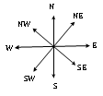
Direction sense is one of the prime topics in Logical Reasoning. Questions from this topic generally involve an individual travelling certain distances in certain directions. The best way to solve these problems is to represent the traces of the path traversed by the person, as provided by the questions.
Four directions and four sub directions are shown in the image.
I. North (N), East (E), South (S) and West (W) are four directions.
II. While South-East (SE), South-West (SW), North-West (NW) and North-East (NE) are four cardinal directions.

Slide 63
1. One day, Raviraj left home and cycled 20 km southwards, turned right and cycled 10 km and turned right and cycled 20 km and turned left and cycled 20 km. How many kilometres will he have to cycle to reach his home straight?
(a) 50 km (b) 30 km
(c) 40 km (d) 60 km
2. If South-East becomes North, North-East becomes West and so on. What will West become?
(a) North-East (b) North-West
(c) South-East (d) South-West

Slide 64
3. Y is in the East of X which is in the North of Z. If P is in the South of Z, then in which direction of Y, is P?
(a) North (b) South
(c) South-East (d) South-West
4. Golu started from his house towards North. After covering a distance of 8 km. he turned towards left and covered a distance of 6 km. What is the shortest distance now from his house?
(a) 10 km (b) 16 km
(c) 14 km (d) 2 km

Slide 65
5. Vishwanath was walking on the road early morning after the sunrise and his shadow was failing to his left. Which direction was he facing?
(a) East (b) North
(c) West (d) Either East or West
6. A, B, C, D are playing game of carom. A, B and C, D are partners. C is to the left of B who is facing east. Then D is facing
(a) North (b) South
(c) East (d) West

Slide 66
7. A is 40 m South-West of B. C is 40 m South-East of B. Then C is in which direction of A?
(a) East (b) West
(c) North-east (d) South
8. After walking 6 km, I turned right and covered a distance of 2 km, then turned left and covered a distance of 10 km. In the end, I was moving towards the north. From which direction did I start my journey?
(a) North (b) South
(c) East (d) West

Slide 67
9. If 'South-east' is called 'East', 'North-West' is called 'West', 'South-West' is called 'South' and so on, what will 'North' be called?
(a) East (b) North-East
(c) North-West (d) South
10. Sanmitra walks 4 km. Towards North, turns right and walks 5 km. Then he turns towards South and walks 2 km. Again he takes a turn towards west walks 3 km and stops for a while. Then he further walks 2 km. What is the distance of Sanmitra from starting point?
(a) 16 km (b) 2 km
(c) 4 km (d) 3 km

Slide 68
11. A boy is facing towards North-West and turns 180º clockwise, again 45º clockwise and then turns through 270º anti-clockwise. In which direction is he facing now?
(a) West (b) North-West
(c) South-West (d) South
12. A river flows West to East and on the way turns left and runs in a semi-circular path around a hillock and then turns left at right angle. In which direction is the river finally flowing?
(a) North (b) West
(c) South (d) East

Slide 69
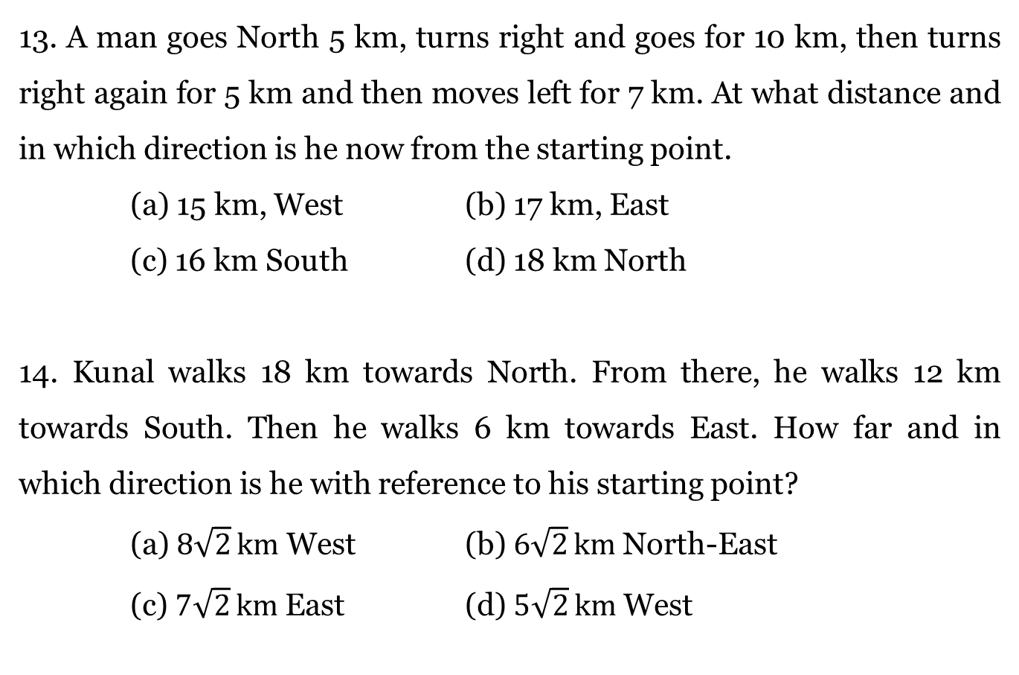
13. A man goes North 5 km, turns right and goes for 10 km, then turns right again for 5 km and then moves left for 7 km. At what distance and in which direction is he now from the starting point.
(a) 15 km, West (b) 17 km, East
(c) 16 km South (d) 18 km North
14. Kunal walks 18 km towards North. From there, he walks 12 km towards South. Then he walks 6 km towards East. How far and in which direction is he with reference to his starting point?
(a) $8\sqrt{2} km$ West (b) $6\sqrt{2} km$ North-East
(c) $7\sqrt{2} km$ East (d) $5\sqrt{2} km$ West

Slide 70
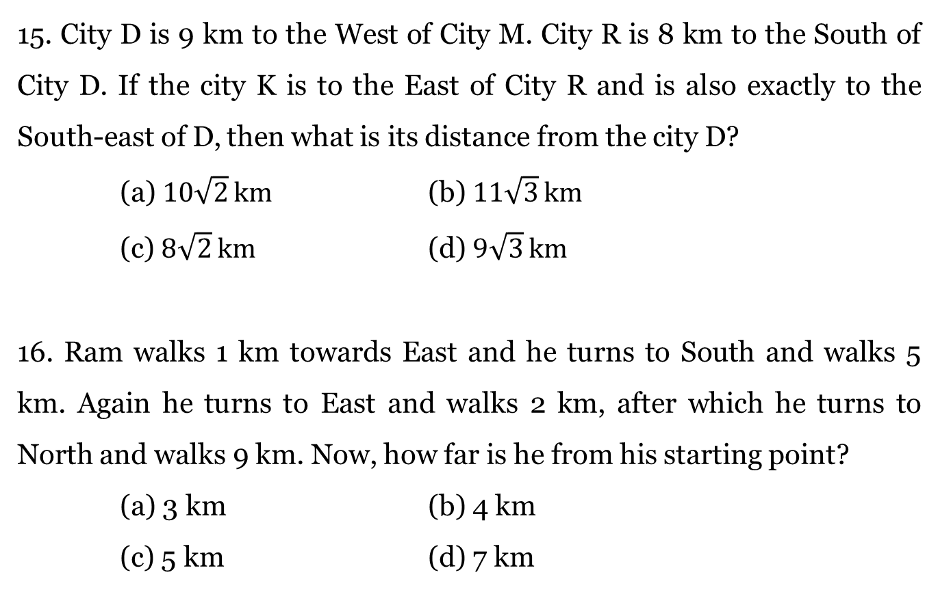
15. City D is 9 km to the West of City M. City R is 8 km to the South of City D. If the city K is to the East of City R and is also exactly to the South-east of D, then what is its distance from the city D?
(a) $10\sqrt{2} km$ (b) $11\sqrt{3} km$
(c) $8\sqrt{2} km$ (d) $9\sqrt{3} km$
16. Ram walks 1 km towards East and he turns to South and walks 5 km. Again he turns to East and walks 2 km, after which he turns to North and walks 9 km. Now, how far is he from his starting point?
(a) 3 km (b) 4 km
(c) 5 km (d) 7 km

Slide 71
17. X walks 10 metres towards East and then 10 metres to the right. Then, every time turning to his left, he walks 5, 15 and 15 metres respectively. How far and in which direction is he now from the starting point?
(a) 5 metres, North
(b) 10 metres, North-East
(c) 7 metres, South
(d) 12 metres, North-West

Slide 72
18. A and B start moving towards each other from two places 200 m apart. After walking 60 m, B turns left and goes 20 m, then he turns right and goes 40 m. He then turns right again and comes back to the road on which he was initially walking. If A and B walk with the same speed, what is the distance between them now?
(a) 20 m (b) 30 m
(c) 40 m (d) 50 m

Slide 73
19. Five villages P, Q, R, S and T are situated close to one another. P is 2 km to the West of Q, R is 2 km to the South of P, T is 2 km to the North of Q and S is 2 km to the East of T. Then how far and in which direction is R located with reference to S?
(a) 5 km, North-West (b) 5 km, South-East
(c) 6 km, South-West (d) None of these
20. The time in a clock is exactly 3 p.m.. Now the clock is turned in such a way that the minute hand points to East. What is the direction now opposite to the hour hand?
(a) South-West (b) South
(c) West (d) North

Slide 74
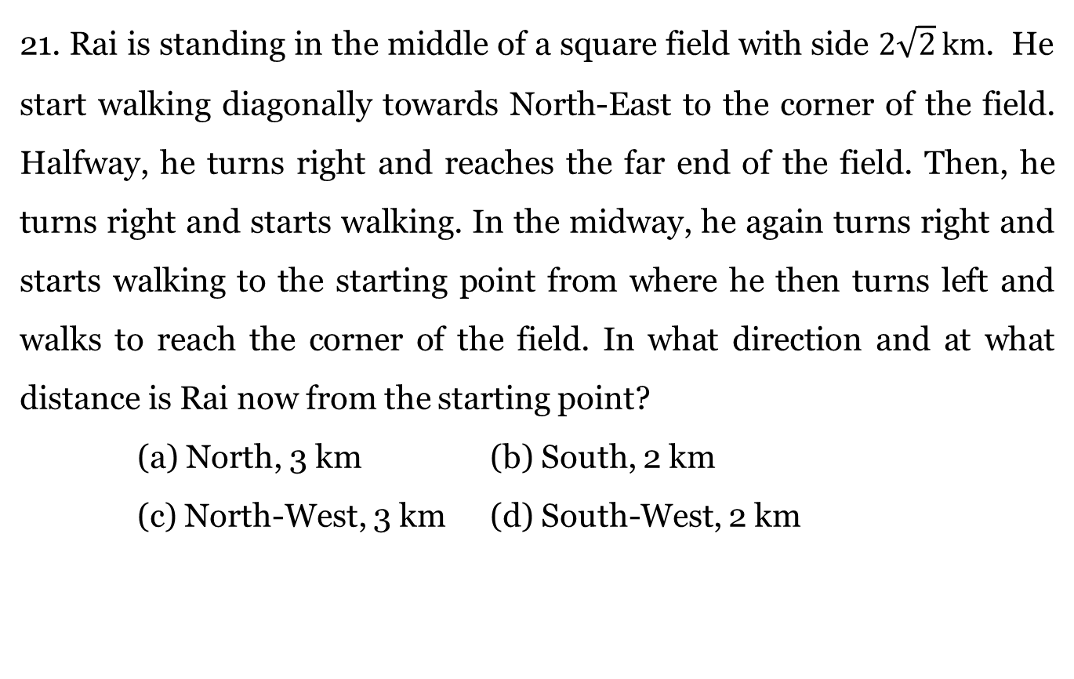
21. Rai is standing in the middle of a square field with side $2\sqrt{2} km$. He start walking diagonally towards North-East to the corner of the field. Halfway, he turns right and reaches the far end of the field. Then, he turns right and starts walking. In the midway, he again turns right and starts walking to the starting point from where he then turns left and walks to reach the corner of the field. In what direction and at what distance is Rai now from the starting point?
(a) North, 3 km (b) South, 2 km
(c) North-West, 3 km (d) South-West, 2 km

Slide 75
22. Ram and Roy started from a place X. Ram went West and Roy went North, both travelling with the same speed. After some time, both turned to the left and walked a few steps. They again turned to the left and walked the same distance. Then Ram turned 45º clockwise and Roy turned 45º anti-clockwise. Which directions will they be facing now?
(a) South-East, North-East
(b) South-West, North-West
(c) South, North
(d) West, East

Slide 76
23. W walked 40 m towards West took a left turn and walked 30 m. He, then, took a right turn and walked 20 m. He again took a right turn and walked 30 m after which he once again turned right and walked one-third of the previous distance. How far and in what direction is he now from the starting point?
(a) 40 m, West (b) 45 m, East
(c) 50 m, West (d) 50, South

Slide 77
24. Two buses start from the opposite points A and B, on the main road, 150 km apart. The first bus runs 25 km and takes a right turn and then runs for 15 km. It then turns left and runs for another 25 km and takes the direction to reach back the main road. In the meantime, the other bus runs 40 km along the main road and then turns left to run 25 km. At this stage, what is the distance between the two buses?
(a) 70 km (b) 55 km
(c) 60 km (d) 65 km

Slide 78
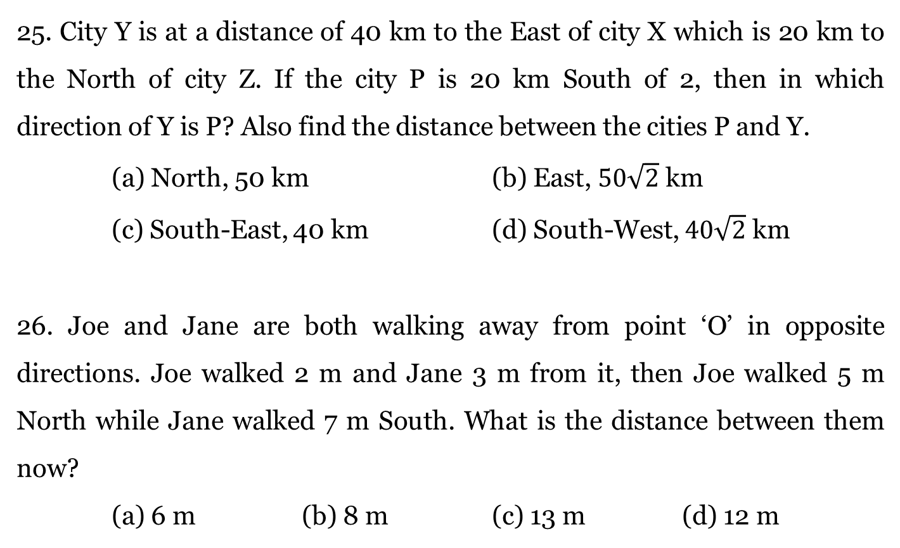
25. City Y is at a distance of 40 km to the East of city X which is 20 km to the North of city Z. If the city P is 20 km South of 2, then in which direction of Y is P? Also find the distance between the cities P and Y.
(a) North, 50 km (b) East, $50\sqrt{2}$ km
(c) South-East, 40 km (d) South-West, $40\sqrt{2}$ km
26. Joe and Jane are both walking away from point ‘O’ in opposite directions. Joe walked 2 m and Jane 3 m from it, then Joe walked 5 m North while Jane walked 7 m South. What is the distance between them now?
(a) 6 m (b) 8 m (c) 13 m (d) 12 m

Slide 79
27. Town D is 20 km to the West of town M. Town R is 15 km to the South of town D. Town K is to the East of town R and at a distance of 15 km from the town M. Town K is in what direction and at what distance from the town D?
(a) 25 km, South-West (b) 28 km, East
(c) 30 km, South (d) 25 km, South-East
28. Karim walked 5 m towards North, took a left turn and walked for 10 m. He then took a right turn and walked for 20 m and again took a right turn and walked 10 m. How far is he then from the starting point and also in what direction?
(a) 20 m, East (b) 15 m, South
(c) 25 m, North (d) 30 m, West

Slide 80
29. Kunal walks 10 km towards North. From there he walks 6 km towards South. Then, he walks 3 km towards his left. How far and in which direction is he with reference to his starting point?
(a) 5 km, West
(b) 7 km, West
(c) 6 km, East
(d) 5 km, North-East

Slide 81
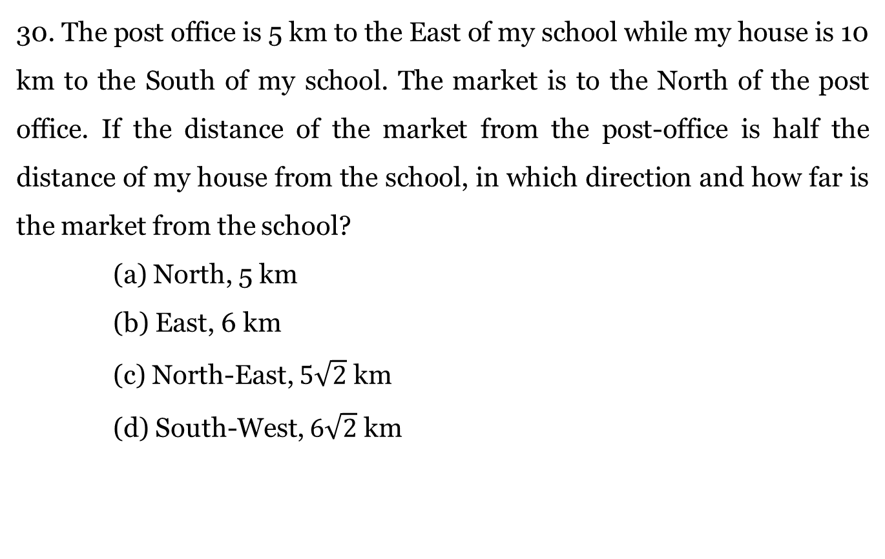
30. The post office is 5 km to the East of my school while my house is 10 km to the South of my school. The market is to the North of the post office. If the distance of the market from the post-office is half the distance of my house from the school, in which direction and how far is the market from the school?
(a) North, 5 km
(b) East, 6 km
(c) North-East, $5\sqrt{2}$ km
(d) South-West, $6\sqrt{2}$ km

Slide 82
End of Session - 3

Slide 83
Session - 4
CUBES

Slide 84
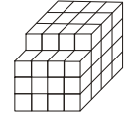
Directions for Q1 to Q5: Read the following passage and answer the questions below.
A solid block is formed by arranging some cubes of equal dimensions, as shown in the figure below. The block is painted pink on all of its surfaces except the base.
1. How many cubes have four faces coloured?
(a) 0 (b) 1 (c) 2 (d) 3

Slide 85
Directions for Q1 to Q5: Read the following passage and answer the questions below.
A solid block is formed by arranging some cubes of equal dimensions, as shown in the figure below. The block is painted pink on all of its surfaces except the base.
2. How many cubes have exactly three faces coloured?
(a) 2 (b) 4 (c) 6 (d) 11

Slide 86
Directions for Q1 to Q5: Read the following passage and answer the questions below.
A solid block is formed by arranging some cubes of equal dimensions, as shown in the figure below. The block is painted pink on all of its surfaces except the base.
3. How many cubes have exactly two faces coloured?
(a) 9 (b) 11 (c) 18 (d) 15

Slide 87
Directions for Q1 to Q5: Read the following passage and answer the questions below.
A solid block is formed by arranging some cubes of equal dimensions, as shown in the figure below. The block is painted pink on all of its surfaces except the base.
4. How many cubes are not coloured on any face?
(a) 6 (b) 8 (c) 12 (d) 11

Slide 88
Directions for Q1 to Q5: Read the following passage and answer the questions below.
A solid block is formed by arranging some cubes of equal dimensions, as shown in the figure below. The block is painted pink on all of its surfaces except the base.
5. How many cubes have only one face coloured?
(a) 22 (b) 24 (c) 25 (d) 27

Slide 89
Directions for Q6 to Q10: Read the following passage and answer the questions below.
A cube is coloured orange on one face, pink on the opposite face, brown on one face and silver on one face adjacent to the brown face. The other two faces are left uncoloured. It is then cut into 125 smaller cubes of equal size.
6. How many cubes have at least one face painted pink?
(a) 1 (b) 9 (c) 16 (d) 25

Slide 90
Directions for Q6 to Q10: Read the following passage and answer the questions below.
A cube is coloured orange on one face, pink on the opposite face, brown on one face and silver on one face adjacent to the brown face. The other two faces are left uncoloured. It is then cut into 125 smaller cubes of equal size.
7. How many cubes are coloured silver on one face, orange or pink on another face and have four uncoloured faces?
(a) 8 (b) 10 (c) 12 (d) 16

Slide 91
Directions for Q6 to Q10: Read the following passage and answer the questions below.
A cube is coloured orange on one face, pink on the opposite face, brown on one face and silver on one face adjacent to the brown face. The other two faces are left uncoloured. It is then cut into 125 smaller cubes of equal size.
8. How many cubes have all the faces uncoloured?
(a) 24 (b) 36 (c) 48 (d) 64

Slide 92
Directions for Q6 to Q10: Read the following passage and answer the questions below.
A cube is coloured orange on one face, pink on the opposite face, brown on one face and silver on one face adjacent to the brown face. The other two faces are left uncoloured. It is then cut into 125 smaller cubes of equal size.
9. How many cubes are coloured orange on one face and have the remaining faces uncoloured?
(a) 16 (b) 20 (c) 21 (d) 23

Slide 93
Directions for Q6 to Q10: Read the following passage and answer the questions below.
A cube is coloured orange on one face, pink on the opposite face, brown on one face and silver on one face adjacent to the brown face. The other two faces are left uncoloured. It is then cut into 125 smaller cubes of equal size.
10. How many cubes have at least two faces coloured?
(a) 16 (b) 20 (c) 21 (d) 23

Slide 94
Directions for Q11 to Q15: Read the following passage and answer the questions below.
A cube is having the dimensions of 30 x 30 x 30 cm³. Join two cubes having the same dimensions with the previous one on any two adjacent faces. Cut it to get a smaller number of cubes having dimensions of 10 x 10 x 10 cm³ after it was painted.
11. How many cubes are not painted?
(a) 3 (b) 4 (c) 7 (d) 8

Slide 95
Directions for Q11 to Q15: Read the following passage and answer the questions below.
A cube is having the dimensions of 30 x 30 x 30 cm³. Join two cubes having the same dimensions with the previous one on any two adjacent faces. Cut it to get a smaller number of cubes having dimensions of 10 x 10 x 10 cm³ after it was painted.
12. How many cubes are having 2 faces painted?
(a) 18 (b) 24 (c) 28 (d) 25

Slide 96
Directions for Q11 to Q15: Read the following passage and answer the questions below.
A cube is having the dimensions of 30 x 30 x 30 cm³. Join two cubes having the same dimensions with the previous one on any two adjacent faces. Cut it to get a smaller number of cubes having dimensions of 10 x 10 x 10 cm³ after it was painted.
13. How many cubes are having 1 face painted?
(a) 28 (b) 18 (c) 30 (d) None of these

Slide 97
Directions for Q11 to Q15: Read the following passage and answer the questions below.
A cube is having the dimensions of 30 x 30 x 30 cm³. Join two cubes having the same dimensions with the previous one on any two adjacent faces. Cut it to get a smaller number of cubes having dimensions of 10 x 10 x 10 cm³ after it was painted.
14. If we join one more cube of same dimensions on any adjacent face, how many more no face painted cube will be possible?
(a) 10 (b) 11 (c) 3 (d) 2

Slide 98
Directions for Q11 to Q15: Read the following passage and answer the questions below.
A cube is having the dimensions of 30 x 30 x 30 cm³. Join two cubes having the same dimensions with the previous one on any two adjacent faces. Cut it to get a smaller number of cubes having dimensions of 10 x 10 x 10 cm³ after it was painted.
15. What percentage of cubes are having 3 faces painted?
(a) 12.32% (b) 12.30%
(c) 12.42% (d) 12.34%

Slide 99
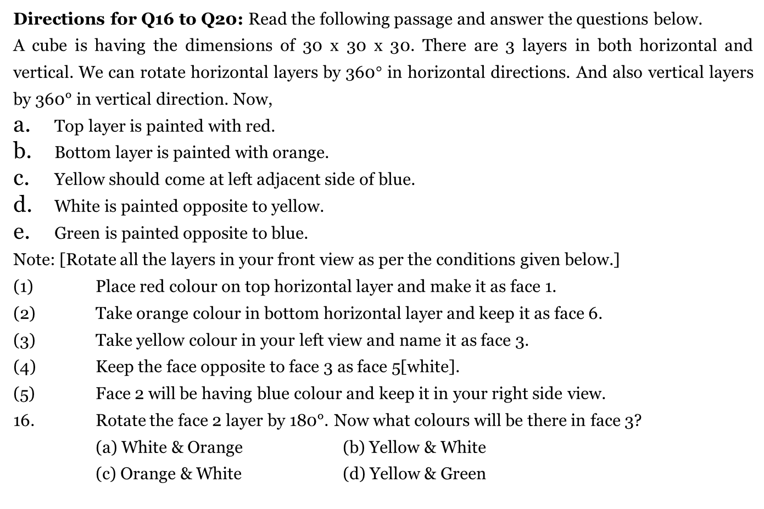
Directions for Q16 to Q20: Read the following passage and answer the questions below.
A cube is having the dimensions of 30 x 30 x 30. There are 3 layers in both horizontal and vertical. We can rotate horizontal layers by 360$°$ in horizontal directions. And also vertical layers by 360° in vertical direction. Now,
Top layer is painted with red.
Bottom layer is painted with orange.
Yellow should come at left adjacent side of blue.
White is painted opposite to yellow.
Green is painted opposite to blue.
Note: [Rotate all the layers in your front view as per the conditions given below.]
(1) Place red colour on top horizontal layer and make it as face 1.
(2) Take orange colour in bottom horizontal layer and keep it as face 6.
(3) Take yellow colour in your left view and name it as face 3.
(4) Keep the face opposite to face 3 as face 5[white].
(5) Face 2 will be having blue colour and keep it in your right side view.
16. Rotate the face 2 layer by 180°. Now what colours will be there in face 3?
(a) White & Orange (b) Yellow & White
(c) Orange & White (d) Yellow & Green

Slide 100
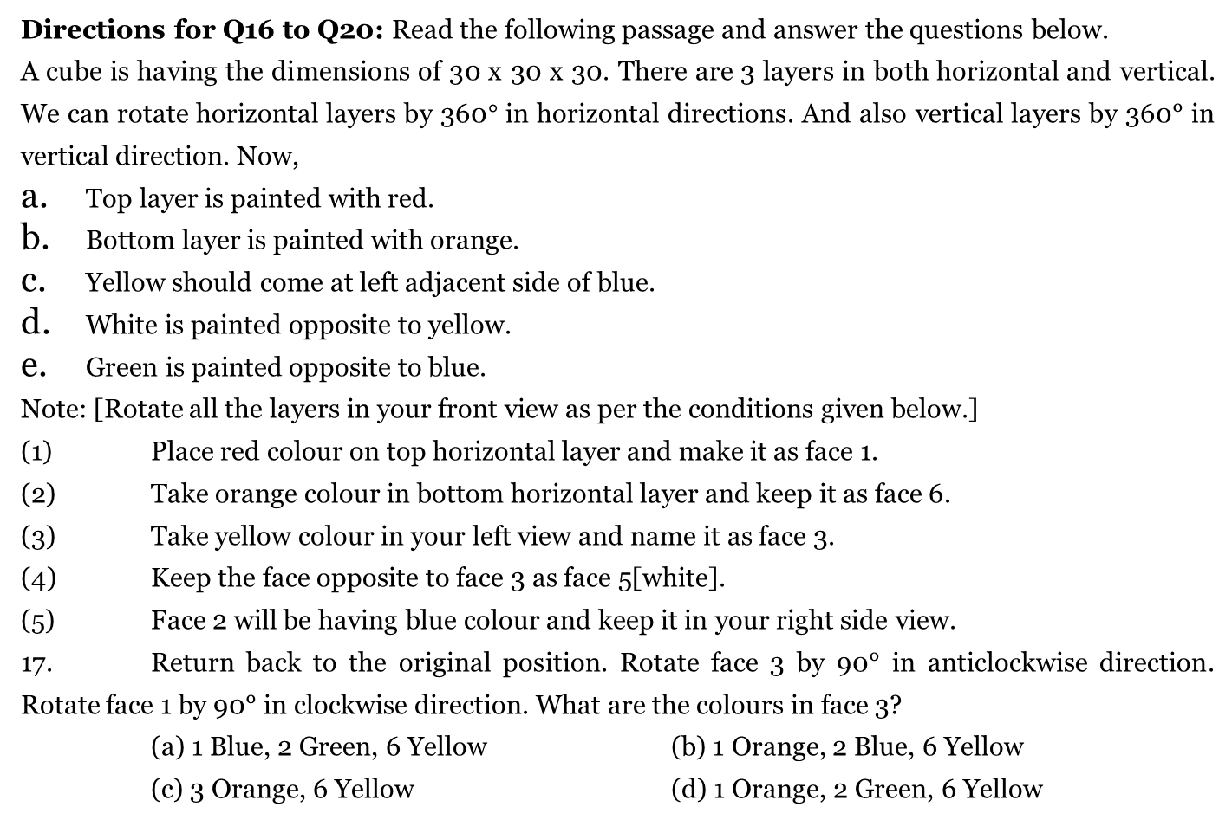
Directions for Q16 to Q20: Read the following passage and answer the questions below.
A cube is having the dimensions of 30 x 30 x 30. There are 3 layers in both horizontal and vertical. We can rotate horizontal layers by 360$°$ in horizontal directions. And also vertical layers by 360° in vertical direction. Now,
Top layer is painted with red.
Bottom layer is painted with orange.
Yellow should come at left adjacent side of blue.
White is painted opposite to yellow.
Green is painted opposite to blue.
Note: [Rotate all the layers in your front view as per the conditions given below.]
(1) Place red colour on top horizontal layer and make it as face 1.
(2) Take orange colour in bottom horizontal layer and keep it as face 6.
(3) Take yellow colour in your left view and name it as face 3.
(4) Keep the face opposite to face 3 as face 5[white].
(5) Face 2 will be having blue colour and keep it in your right side view.
17. Return back to the original position. Rotate face 3 by 90° in anticlockwise direction. Rotate face 1 by 90° in clockwise direction. What are the colours in face 3?
(a) 1 Blue, 2 Green, 6 Yellow (b) 1 Orange, 2 Blue, 6 Yellow
(c) 3 Orange, 6 Yellow (d) 1 Orange, 2 Green, 6 Yellow

Slide 101
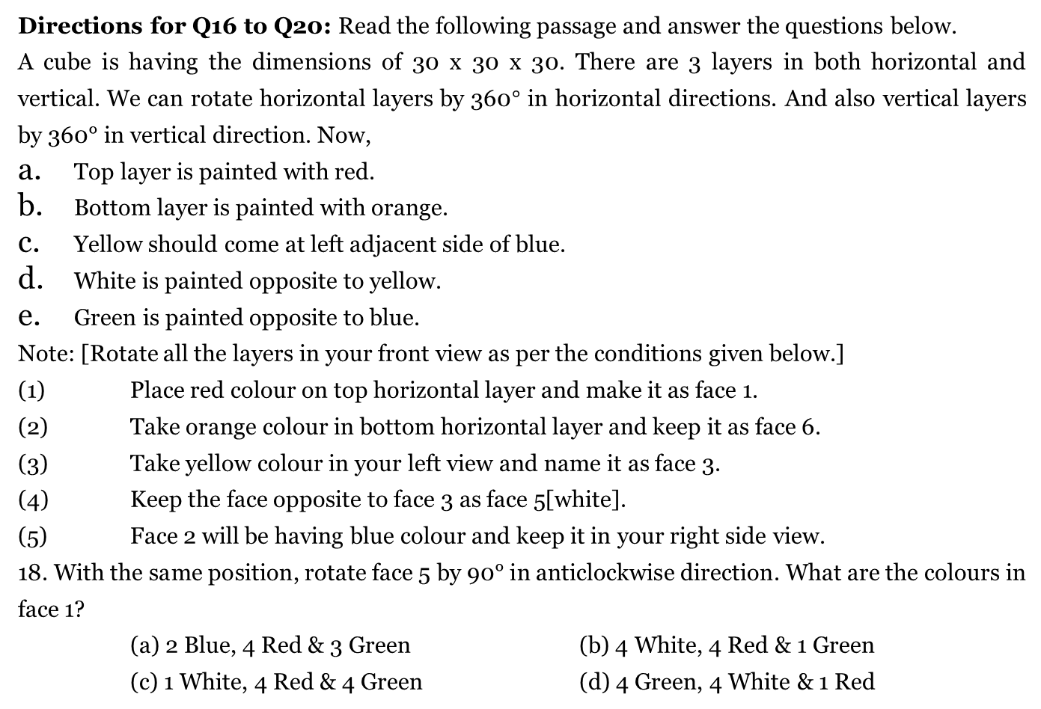
Directions for Q16 to Q20: Read the following passage and answer the questions below.
A cube is having the dimensions of 30 x 30 x 30. There are 3 layers in both horizontal and vertical. We can rotate horizontal layers by 360$°$ in horizontal directions. And also vertical layers by 360° in vertical direction. Now,
Top layer is painted with red.
Bottom layer is painted with orange.
Yellow should come at left adjacent side of blue.
White is painted opposite to yellow.
Green is painted opposite to blue.
Note: [Rotate all the layers in your front view as per the conditions given below.]
(1) Place red colour on top horizontal layer and make it as face 1.
(2) Take orange colour in bottom horizontal layer and keep it as face 6.
(3) Take yellow colour in your left view and name it as face 3.
(4) Keep the face opposite to face 3 as face 5[white].
(5) Face 2 will be having blue colour and keep it in your right side view.
18. With the same position, rotate face 5 by 90° in anticlockwise direction. What are the colours in face 1?
(a) 2 Blue, 4 Red & 3 Green (b) 4 White, 4 Red & 1 Green
(c) 1 White, 4 Red & 4 Green (d) 4 Green, 4 White & 1 Red

Slide 102
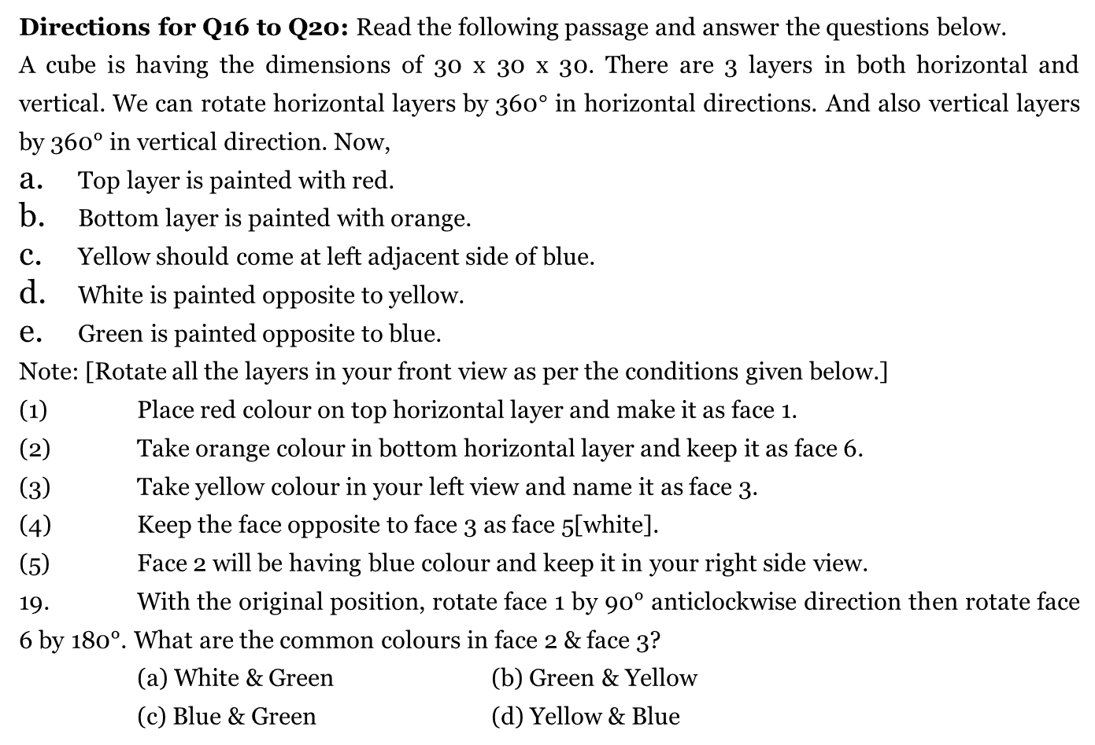
Directions for Q16 to Q20: Read the following passage and answer the questions below.
A cube is having the dimensions of 30 x 30 x 30. There are 3 layers in both horizontal and vertical. We can rotate horizontal layers by 360$°$ in horizontal directions. And also vertical layers by 360° in vertical direction. Now,
Top layer is painted with red.
Bottom layer is painted with orange.
Yellow should come at left adjacent side of blue.
White is painted opposite to yellow.
Green is painted opposite to blue.
Note: [Rotate all the layers in your front view as per the conditions given below.]
(1) Place red colour on top horizontal layer and make it as face 1.
(2) Take orange colour in bottom horizontal layer and keep it as face 6.
(3) Take yellow colour in your left view and name it as face 3.
(4) Keep the face opposite to face 3 as face 5[white].
(5) Face 2 will be having blue colour and keep it in your right side view.
19. With the original position, rotate face 1 by 90° anticlockwise direction then rotate face 6 by 180°. What are the common colours in face 2 & face 3?
(a) White & Green (b) Green & Yellow
(c) Blue & Green (d) Yellow & Blue

Slide 103
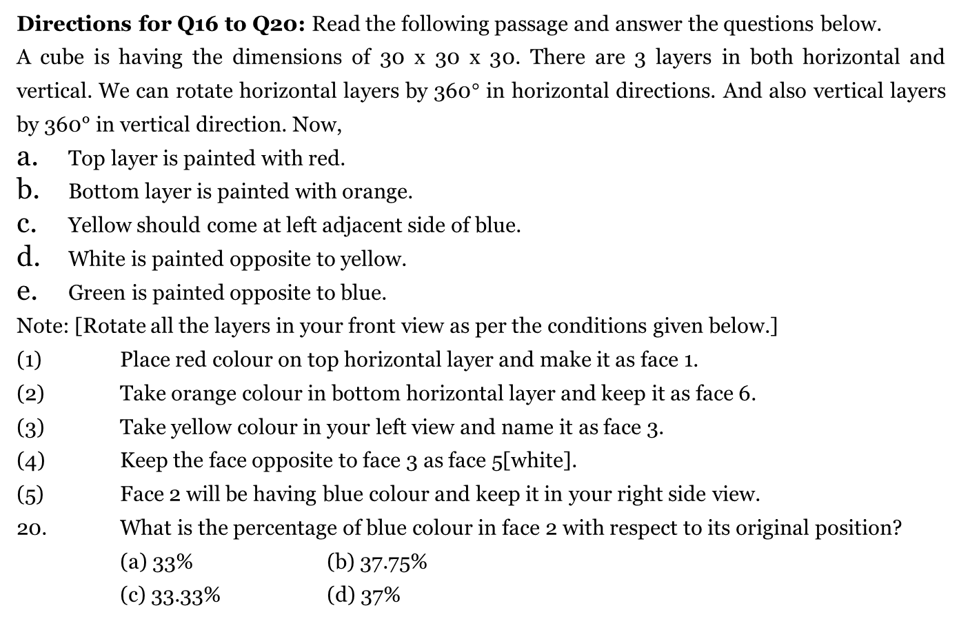
Directions for Q16 to Q20: Read the following passage and answer the questions below.
A cube is having the dimensions of 30 x 30 x 30. There are 3 layers in both horizontal and vertical. We can rotate horizontal layers by 360$°$ in horizontal directions. And also vertical layers by 360° in vertical direction. Now,
Top layer is painted with red.
Bottom layer is painted with orange.
Yellow should come at left adjacent side of blue.
White is painted opposite to yellow.
Green is painted opposite to blue.
Note: [Rotate all the layers in your front view as per the conditions given below.]
(1) Place red colour on top horizontal layer and make it as face 1.
(2) Take orange colour in bottom horizontal layer and keep it as face 6.
(3) Take yellow colour in your left view and name it as face 3.
(4) Keep the face opposite to face 3 as face 5[white].
(5) Face 2 will be having blue colour and keep it in your right side view.
20. What is the percentage of blue colour in face 2 with respect to its original position?
(a) 33% (b) 37.75%
(c) 33.33% (d) 37%

Slide 104
End of Session - 4

Slide 105
SESSION – 5 DATA INTERPRETATION - TABLES

Slide 106
Directions for Q1 to Q5: Answer the questions based on the following information . The following table gives the percentage change in the sales of Mobile phones over that in the previous year for five companies.
Company | 2002 | 2003 | 2004 | 2005 | 2006
Tokia | 10% | 20% | – 15% | 25% | 8%
Zamsung | 15% | 25% | – 30% | 8% | 20%
Notorola | 10% | – 10% | 15% | 20% | 15%
Mericsson | – 10% | 20% | 10% | 15% | – 10%
Rower | 20% | 15% | 10% | – 20% | 30%
Here “–” indicates decrease . The following table gives the total sales of the given companies in the year 2001(Number of pieces in Millions)
Year | Tokia | Zamsung | Notorola | Mericsson | Rower
2001 | 32 | 48 | 56 | 50 | 60

Slide 107
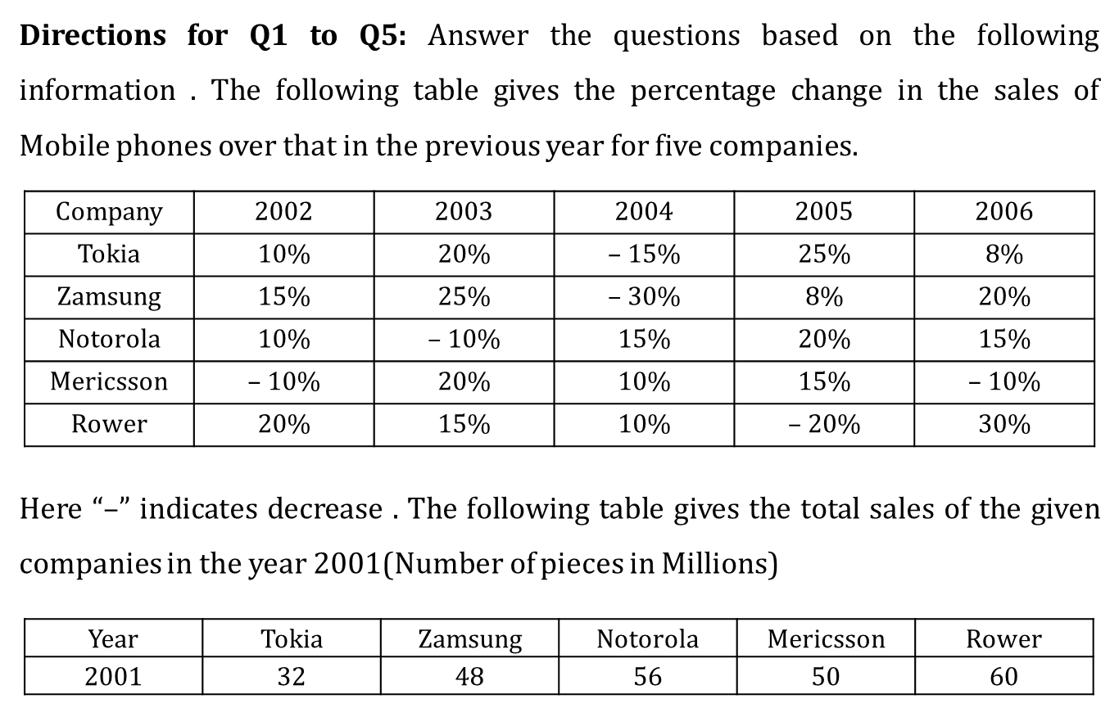
What is the total number of Tokia mobiles sold(in million) in 2006 (approximately)?
(a) 50 (b) 45 (c) 48 (d) 52
Notes:
1. Ans: [c]
Total number of Tokia mobiles sold in 2007
= 32000000 * $\frac{110}{100}$ * $\frac{120}{100}∗\frac{85}{100}∗\frac{125}{100}∗\frac{108}{100}$ = 48 million

Slide 108
What is the ratio of number of Zamsung mobiles sold in 2004 to the number of Mericsson mobiles sold in the same year?
(a) 10:13 (b) 121:360 (c) 11:12 (d) None of these
Notes:
1. Ans: [c]
Total number of Tokia mobiles sold in 2007
= 32000000 * $\frac{110}{100}$ * $\frac{120}{100}∗\frac{85}{100}∗\frac{125}{100}∗\frac{108}{100}$ = 48 million
2. Ans: [d]
The number of Zamsung mobiles sold in 2004
= 48000000 * $\frac{115}{100}∗\frac{125}{100}∗\frac{70}{100}$ = 48300000
The number of Mericson mobiles sold in 2004
= 50000000 * $\frac{90}{100}∗\frac{120}{100}∗\frac{110}{100}$ = 59400000
Therefore required percentage = $\frac{483}{594}$
$→ \frac{161}{198}$ $≃4:5$

Slide 109
What is the approximate difference between the number of Notorola mobiles sold in 2005 and the number of Rower mobiles sold in the same year(in millions)?
(a) 3.5 (b) 5 (c) 10 (d) 13
Notes:
3. Ans: [a]
The number of Notorola mobiles sold in 2005
= 56 * 1.1 * 0.9 * 1.15 * 1.2 ~ 76.5
The number of Rower mobiles sold in 2005
= 60 * 1.2 * 1.15 * 1.1 * 0.8 ~ 73
Therefore, required difference = 3.5

Slide 110
What is the total number of mobiles sold by the given companies in 2002(in millions)?
(a) 253 (b) 269 (c) 274 (d) 263
Notes:
4. Ans: [b]
Total number of mobiles sold in 2002
= 32 * 1.1 + 48 * 1.15 + 56 * 1.1 + 50 * 0.9 + 60 * 1.2 = 269

Slide 111
How many Zamsung mobiles were sold in 2005 (in millions)?
(a) 52.164 (b) 55.384 (c) 50.286 (d) 49.268
Notes:
5. Ans: [a]
Total number of Zamsung sold in 2005(in millions)
= 48 * 1.15 * 1.25 * 0.7 * 1.08 = 52.164

Slide 112
Directions for Q6 to Q10: Answer the questions based on the following table which gives the data relating to salt industry over a period of four years. All figures are in lakhs of tonnes(Lt).
 | 2007–08(Actual) | 2008–09(Provisional) | 2009–10(Estimate) | 2010–11(Forecast)
Opening stock with factories | 41 | 88 | 169 | 88
Buffer stock | 85 | 62 | 56 | 67
Production | 275 | 300 | 180 | 230
Total supply | 360 | 450 | 405 | 385
OFF take Domestic | 180 | 190 | 200 | 210
Exports | 30 | 35 | 50 | 40
Total demand | 210 | 225 | 250 | 250
Balance | 150 | 225 | 155 | 135
Note: Balance = Total supply – Total demand

Slide 113
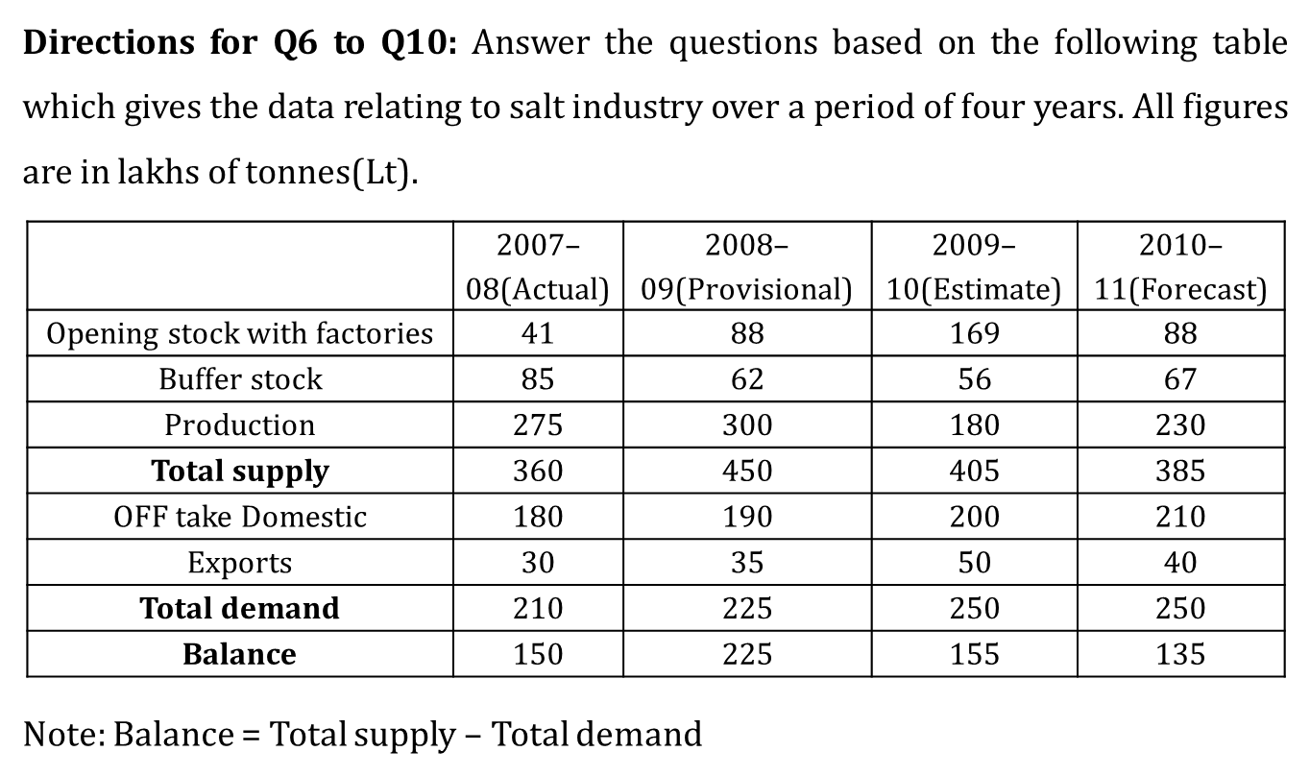
Supposing that in 2007–08, the domestic demand for salt was 20% more than the value given and the forecast production in 2010–11 was 30% less, then find the difference between the two values(in lakh tonnes).
(a) 69 (b) 52 (c) 55 (d) 50
Notes:
6. Ans: [c]
Domestic demand in 2007 – 08
= 180 * $\frac{120}{100}$ = 216
Forecast production in 2010 – 2011
= 230 * $\frac{70}{100}$ = 161
Difference = 216 – 161 = 55 lakh tonnes

Slide 114
Supposing that in 2007–08, the total demand for salt was 12% higher than that mentioned in the table, then the new total supply demand gap for 2007–08 (if all other values remained the same) would be(in lakh tonnes)
(a) 124.8 (b) 114.8 (c) 104.8 (d) 94.8
Notes:
6. Ans: [c]
Domestic demand in 2007 – 08
= 180 * $\frac{120}{100}$ = 216
Forecast production in 2010 – 2011
= 230 * $\frac{70}{100}$ = 161
Difference = 216 – 161 = 55 lakh tonnes

Slide 115
The excess of forecast demand for 2010–11 over the estimated total demand for 2009–10 is (in lakh tonnes)
(a) 3.2 (b) 1.6 (c) 0.8 (d) Nil
Notes:
6. Ans: [c]
Domestic demand in 2007 – 08
= 180 * $\frac{120}{100}$ = 216
Forecast production in 2010 – 2011
= 230 * $\frac{70}{100}$ = 161
Difference = 216 – 161 = 55 lakh tonnes

Slide 116
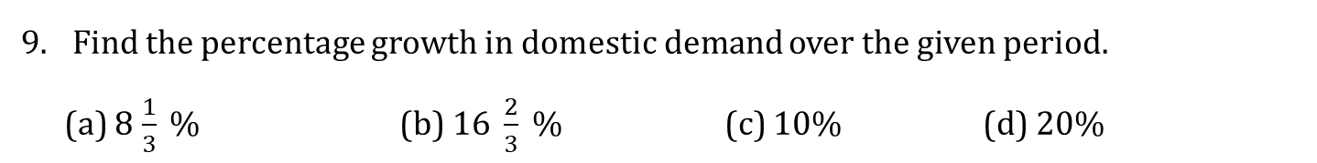
Find the percentage growth in domestic demand over the given period.
(a) 8$\frac{1}{3} \%$ (b) 1$6 \frac{2}{3} \%$ (c) 10% (d) 20%
Notes:
6. Ans: [c]
Domestic demand in 2007 – 08
= 180 * $\frac{120}{100}$ = 216
Forecast production in 2010 – 2011
= 230 * $\frac{70}{100}$ = 161
Difference = 216 – 161 = 55 lakh tonnes

Slide 117
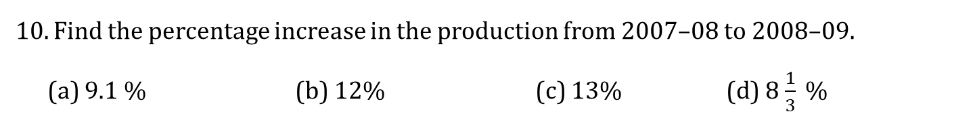
Find the percentage increase in the production from 2007–08 to 2008–09.
(a) 9.1 % (b) 12% (c) 13% (d) 8$\frac{1}{3} \%$
Notes:
6. Ans: [c]
Domestic demand in 2007 – 08
= 180 * $\frac{120}{100}$ = 216
Forecast production in 2010 – 2011
= 230 * $\frac{70}{100}$ = 161
Difference = 216 – 161 = 55 lakh tonnes

Slide 118
DATA INTERPRETATION – PIE CHART

Slide 119
Directions for Q1 to Q5: Answer these questions based on the following pie chart which represents the production of certain types of oil seeds in the year 2008.
What is the production of castor seeds? (in tonnes)
(a) 36
(b) 45
(c) 54
(d) 63
Notes:
1. Ans: [b]
The production of castor seeds in 2008
= 30/360 * 540
= 45 tonnes

Slide 120
Directions for Q1 to Q5: Answer these questions based on the following pie chart which represents the production of certain types of oil seeds in the year 2008.
By how much (in tonnes) is the production of soyabean seeds less than that of groundnut seeds?
(a) 75
(b) 85
(c) 92.50
(d) 112.50
Notes:
2. Ans: [d]
The difference in production between the soyabean seeds and the groundnut seeds = (120 – 45/360) * 540
= 112.50 tonnes

Slide 121
Directions for Q1 to Q5: Answer these questions based on the following pie chart which represents the production of certain types of oil seeds in the year 2008.
The production of how many types of oil seeds is more than 108 tonnes?
(a) 2
(b) 1
(c) 4
(d) 3
Notes:
3. Ans: [d]
108 tonnes when converted into degree, we get
= 108/540 * 360
= 72º
The production each of sunflower (75º), mustard (90º) and groundnut (120º) is greater than 72º.
There are 3 types of oil seeds satisfying these conditions.

Slide 122
Directions for Q1 to Q5: Answer these questions based on the following pie chart which represents the production of certain types of oil seeds in the year 2008.
The production of sun flower seeds was approximately what percentage of the total oil seeds production?
(a) 20%
(b) 21%
(c) 22%
(d) 23%
Notes:
4. Ans: [b]
The required percentage is (75/360) * 100
= 20.8%

Slide 123
Directions for Q1 to Q5: Answer these questions based on the following pie chart which represents the production of certain types of oil seeds in the year 2008.
If the ratio of the number of hectares in which mustard seeds and sunflower seeds are grown is 7:8, then what is the ratio of production per hectare of mustard and that of sunflower seeds?
(a) 25:14
(b) 36:35
(c) 48:35
(d) 18:7
Notes:
5. Ans: [c]
The required ratio is (90/7):(75/8)
= 48:35

Slide 124
Directions for Q6 to Q10: Answer these questions based on the pie-chart given below which shows the quantity-wise sales distribution of all the production – A, B, C, D and E of the company ‘XYZ’ in the year 2007.
The sale of product C is how many times that of product B?
(a) 2 times
(b) 3 times
(c) 1.5 times
(d) 2.5 times
Notes:
6. Ans: [b]
The sale of product C is 120/40.
i.e. 3 times of the product B.

Slide 125
Directions for Q6 to Q10: Answer these questions based on the pie-chart given below which shows the quantity-wise sales distribution of all the production – A, B, C, D and E of the company ‘XYZ’ in the year 2007.
If 250 units of product A were sold, then how many total units were sold by company XYZ?
(a) 1500
(b) 1200
(c) 1800
(d) 2100
Notes:
7. Ans: [c]
If 50º = 250 units
then 360º = 360 * 250/50
= 1800 units

Slide 126
Directions for Q6 to Q10: Answer these questions based on the pie-chart given below which shows the quantity-wise sales distribution of all the production – A, B, C, D and E of the company ‘XYZ’ in the year 2007.
If from 2007 to 2008, there is a 20% increase in the total number of units sold by the company XYZ and the sale of product C goes up by 25% during the same period, then what will be the angle of the sector representing C if a new pie chart representing the quantity–wise sale of the production of the company XYZ in 2008 is drawn?
(a) 127º
(b) 130º
(c) 125º
(d) 132º
Notes:
8. Ans: [c]
Sales of C in 2008 = 120 * (1.25)
= 150º (corresponding to pie chart)
Total sales increased by 20%.
i.e. from 360º to 360 (1.2) i.e. 432º
angle of sector of C
= (360 * 150)/432
= 125º

Slide 127
Directions for Q6 to Q10: Answer these questions based on the pie-chart given below which shows the quantity-wise sales distribution of all the production – A, B, C, D and E of the company ‘XYZ’ in the year 2007.
In 2007, if a total of 27000 units of company XYZ are sold, then the number of units of product E sold is
(a) 3240
(b) 3750
(c) 3860
(d) None of these
Notes:
9. Ans: [b]
50/360 * 27000
= 3750

Slide 128
Directions for Q6 to Q10: Answer these questions based on the pie-chart given below which shows the quantity-wise sales distribution of all the production – A, B, C, D and E of the company ‘XYZ’ in the year 2007.
If 1600 units of product B were sold in 2007 and the total number of units sold by the company in 2008 were 20% more than that in 2007, then how many units were sold by the company in 2008?
(a) 17280
(b) 18360
(c) 15340
(d) 16480
Notes:
10. Ans: [a]
The total number of units sold by XYZ in 2007
= 1600 * 360/40
= 14400
The total number of units sold in 2008
= 1.2 * 14400
= 17280

Slide 129
End of Session - 5

Slide 130
SESSION – 6 DATA INTERPRETATION – BAR GRAPH

Slide 131
Directions for Q1 to Q5: Answer these questions based on the following graph.
What is the percentage increase or decrease in the number of trees planted by the voluntary organization in West India from 2000 to 2006?
(a) 25%
(b) 50%
(c) 20%
(d) 30%
Notes:
1. Ans: [d]
Percentage decrease in trees planted in West India from 2000 to 2006 is [(100 – 70)/100] = 30%

Slide 132
Directions for Q1 to Q5: Answer these questions based on the following graph.
In which of the following years was the trend of alternate increase or decrease in the number of trees planted by the voluntary organization in East India not observed?
(a) 2002
(b) 2003
(c) 2001
(d) 2004
Notes:
2. Ans: [b]
The trend of alternate increase or decrease in the number of trees planted by the voluntary organization in East India was not observed in 2003.

Slide 133
Directions for Q1 to Q5: Answer these questions based on the following graph.
What is the total number of trees (in thousands) planted in East and West India in the years 2003 and 2006 together?
(a) 360
(b) 535
(c) 480
(d) 465
Notes:
3. Ans: [a]
The total number of trees (in thousands) planted in East and West India in the years 2003 and 2006 is (70 + 80+ 110 + 100) = 360 thousand

Slide 134
Directions for Q1 to Q5: Answer these questions based on the following graph.
By what percentage is the number of trees planted in East India in 2000 more than that in West India in 2005?
(a) 66.66%
(b) 50%
(c) 40%
(d) 33.33%
Notes:
4. Ans: [d]
Required percentage = [(80 – 60)/60] * 100 = 33.33%

Slide 135
Directions for Q1 to Q5: Answer these questions based on the following graph.
What is the average number of trees (in thousands) planted in West India from 2000 to 2004?
(a) 84
(b) 75
(c) 80
(d) 70
Notes:
5. Ans: [c]
Average number of trees (in thousands) planted in west India from 2000 to 2004 = (100 + 80 + 60 + 100 + 60)/5 = 80

Slide 136
Directions for Q6 to Q10: Study the following graph to answer the questions below.
Only four parties CJP, HAP, ADB, CJB contested the election in each of the four constituencies A, B, C and D in which the elections were held in 2007. The following graph gives the number of votes secured (in thousands) by the candidates of CJP, HAP, ADB in each of the constituencies.
6. In which constituency did CJB get the minimum number of votes?
(a) A
(b) B
(c) C
(d) D
Note: The total number of votes polled in the 4 constituencies are as follows
A – 450000 B – 500000
C – 600000 D – 575000
Notes:
11. Ans: [a]
The number of votes received by CJB in
A = 450000 – (110000 + 160000 + 130000) = 50,000
B = 500000 – (200000 + 120000 + 90000) = 90,000
C = 600000 – (170000 + 220000 + 140000) = 70,000
D = 575000 – (80000 + 180000 + 210000) = 105,000
So in A, CJB received minimum number of votes.

Slide 137
Directions for Q6 to Q10: Study the following graph to answer the questions below.
Only four parties CJP, HAP, ADB, CJB contested the election in each of the four constituencies A, B, C and D in which the elections were held in 2007. The following graph gives the number of votes secured (in thousands) by the candidates of CJP, HAP, ADB in each of the constituencies.
7. What is the difference between the number of votes secured by HAP in B and C together and that by ADB in A and D together?
(a) 50,000
(b) 20,0000
(c) 10,000
(d) None of these
Note: The total number of votes polled in the 4 constituencies are as follows
A – 450000 B – 500000
C – 600000 D – 575000
Notes:
12. Ans: [d]
The required difference = (120000 + 220000) – (120000 + 220000) = 0

Slide 138
Directions for Q6 to Q10: Study the following graph to answer the questions below.
Only four parties CJP, HAP, ADB, CJB contested the election in each of the four constituencies A, B, C and D in which the elections were held in 2007. The following graph gives the number of votes secured (in thousands) by the candidates of CJP, HAP, ADB in each of the constituencies.
8. The number of votes secured by HAP in B is what percentage of the number of votes it received in A, B, C and D put together?
(a) 20.8%
(b) 17.6%
(c) 14.3%
(d) 15.8%
Note: The total number of votes polled in the 4 constituencies are as follows
A – 450000 B – 500000
C – 600000 D – 575000
Notes:
13. Ans: [b]
The required percentage = [120000/(160000 + 120000 + 220000 + 180000)] * 100 ~ 17.6%

Slide 139
Directions for Q6 to Q10: Study the following graph to answer the questions below.
Only four parties CJP, HAP, ADB, CJB contested the election in each of the four constituencies A, B, C and D in which the elections were held in 2007. The following graph gives the number of votes secured (in thousands) by the candidates of CJP, HAP, ADB in each of the constituencies.
9. In how many constituencies are the votes received by CJB as a percentage of the total votes cast in that constituency more than 17%?
(a) 0
(b) 1
(c) 2
(d) 3
Note: The total number of votes polled in the 4 constituencies are as follows
A – 450000 B – 500000
C – 600000 D – 575000
Notes:
14. Ans: [c]
Percentage of votes received by CJB in
A = (50000/450000) * 100 = 11$\frac{1}{9}$%
B = (90000/500000) * 100 = 18%
C = (70000/600000) * 100 = 11$\frac{2}{3}$%
D = (105000/575000) * 100 = 18.2%
In 2 constituencies, CJB received more than 17%.

Slide 140
Directions for Q6 to Q10: Study the following graph to answer the questions below.
Only four parties CJP, HAP, ADB, CJB contested the election in each of the four constituencies A, B, C and D in which the elections were held in 2007. The following graph gives the number of votes secured (in thousands) by the candidates of CJP, HAP, ADB in each of the constituencies.
10. What is the ratio of number of votes secured by HAP in B and D to that secured by CJB in A and C?
(a) 5:3
(b) 5:4
(c) 3:2
(d) 5:2
Note: The total number of votes polled in the 4 constituencies are as follows
A – 450000 B – 500000
C – 600000 D – 575000

Slide 141
DATA INTERPRETATION – LINE GRAPH

Slide 142
Directions for Q11 to Q15: Answer the questions given as per details given in the graph, which provides the consumption of metal and plastic across 6 years.
What is the number of years for which the consumption of metal was less than the consumption of plastic over the given period?
(a) 4
(b) 2
(c) 3
(d) 5
Notes:
11. Ans: [d]
From the graph it is observed that the consumption of metal was less than the consumption of plastic for 5 years from 2002 to 2006.

Slide 143
Directions for Q11 to Q15: Answer the questions given as per details given in the graph, which provides the consumption of metal and plastic across 6 years.
For how many years has the consumption of metal and plastic put together showed a decrease over the previous year’s consumption?
(a) 2
(b) 1
(c) 3
(d) 4
Notes:
12. Ans: [b]
Total consumption (in thousand tonnes)
2001 – 50
2002 – 50
2003 – 50
2004 – 45
2005 – 45
2006 – 55
Only in 2004, the total consumption was less than that in the previous year.

Slide 144
Directions for Q11 to Q15: Answer the questions given as per details given in the graph, which provides the consumption of metal and plastic across 6 years.
What is the ratio of the total consumption of metal to that of plastic in the given period?
(a) 4:5
(b) 18:23
(c) 19:23
(d) 24:35
Notes:
13. Ans: [d]
Total consumption of metal
= 30 + 20 + 20 + 20 + 15 + 15 + = 120 thousand tonnes
Total consumption of plastic
= 20 + 30 + 30 + 25 + 30 + 40 + = 175 thousand tonnes
The required ratio = 120:175 = 24:35

Slide 145
Directions for Q11 to Q15: Answer the questions given as per details given in the graph, which provides the consumption of metal and plastic across 6 years.
What is the percentage increase in the total consumption of the products in 2006, over that in 2005?
(a) 33 1/3%
(b) 22 2/9%
(c) 16 2/3%
(d) 37.5%
Notes:
14. Ans: [b]
In the year 2006, the percentage increase in the total consumption over that in 2005 = (10/45) * 100 = 22 $\frac{2}{9}\%$

Slide 146
Directions for Q11 to Q15: Answer the questions given as per details given in the graph, which provides the consumption of metal and plastic across 6 years.
During which period did the consumption of both the products, shows a similar trend (both increasing / decreasing / constant)?
(a) 2330–04
(b) 2002–03
(c) 2001–02
(d) 2005–06
Notes:
15. Ans: [b]
Only for one year, the consumption remained constant for both the products i.e. 2002 – 03.

Slide 147
Directions for Q16 to Q20: Answer these questions based on the following line graph which shows the performance of students of six schools P, Q, R, S, T and U in a board exam.
In which of the following schools is the percentage of students passing without distinction, the least?
(a) P
(b) R
(c) S
(d) U
Notes:
16. Ans: [a]
The percentage of students who passed without distinction.
In P = (200/1000) * 100 = 20%
In R = (600/1500) * 100 = 40%
In S = (450/1000) * 100 = 45%
In U = (750/1500) * 100 = 50%

Slide 148
Directions for Q16 to Q20: Answer these questions based on the following line graph which shows the performance of students of six schools P, Q, R, S, T and U in a board exam.
In how many schools is the pass percentage at least 80?
(a) 1
(b) 2
(c) 3
(d) 4
Notes:
17. Ans: [c]
By observation, we can say that in schools, P, Q and R, the pass percentage is less than 80%.
School S = 800 = 80% of 1000
School T = 1250 > 80% of 1300
School U = 1250 > 80% of 1500
In S, T and U, the pass percentage is at least 80%.

Slide 149
Directions for Q16 to Q20: Answer these questions based on the following line graph which shows the performance of students of six schools P, Q, R, S, T and U in a board exam.
In which of the following schools is the ratio of the number of students passing with distinction to those failing, the least?
(a) Q
(b) R
(c) P
(d) T
Notes:
18. Ans: [c]
The ratio of the number of students passing with distinction to those failing
In Q = 400/650 = 8/13 = 0.61
In R = 400/500 = 4/5 = 0.8
In P = 300/500 = 3/5 = 0.6
In T = 600/50 = 12
3/5 is the least among the given values and hence, School P.

Slide 150
Directions for Q16 to Q20: Answer these questions based on the following line graph which shows the performance of students of six schools P, Q, R, S, T and U in a board exam.
Considering all the six schools, what percentage of the students has passed with distinction?
(a) 33.1%
(b) 33.8%
(c) 34.2%
(d) 35.6%
Notes:
19. Ans: [a]
The overall pass percentage with distinction
= (300 + 400 + 400 + 350 + 600 + 500 )/ (1000 + 1400 + 1500 + 1000 + 1300 + 1500 * 100)
= (2550/7700) * 100 = 33.1%

Slide 151
Directions for Q16 to Q20: Answer these questions based on the following line graph which shows the performance of students of six schools P, Q, R, S, T and U in a board exam.
What is the ratio of the total number of students who failed to those who passed, in all the six schools together?
(a) 43:121
(b) 21:37
(c) 43:111
(d) 21:38
Notes:
20. Ans: [c]
The total number of students who passed = 5550
The total number of students who failed = 7700 – 5550 = 2150
The required ratio = 2150/5550 = 43/111

Slide 152
End of Session - 6

Slide 153
SESSION – 7 DATA INTERPRETATION – DOUBLE GRAPH

Slide 154
Directions for Q1 to Q5: Study the following pie-charts carefully to answer these questions.
The pie-charts show the percentage distribution of the manufacturing cost (cost price) of articles A and B.
1. The labour cost incurred in manufacturing B is approximately what percentage more/ less than that of A?
(a) 30%
(b) 25%
(c) 22%
(d) 20%
Notes:
11. Ans: [c]
Labour cost of A = 4050
Labour cost of B = 24800 * 20/100 = 4960
Required % = 4960 – 4050/4050 * 100
= 910/4050 * 100
~ 22%

Slide 155
Directions for Q1 to Q5: Study the following pie-charts carefully to answer these questions.
The pie-charts show the percentage distribution of the manufacturing cost (cost price) of articles A and B.
2. If the profit earned by selling A is 25% and that earned by selling B is 20%, then what is the ratio of the selling prices of A and B?
(a) 675:992
(b) 484:1125
(c) 789:1280
(d) 111:237
Notes:
12. Ans: [a]
The selling price of A = 125/100 * 16200 = 20250
The selling price of B = 120 * 100 * 24800 = 29760
The required ratio = 20250/29760
= 675/992

Slide 156
Directions for Q1 to Q5: Study the following pie-charts carefully to answer these questions.
The pie-charts show the percentage distribution of the manufacturing cost (cost price) of articles A and B.
3. If the transportation cost incurred in manufacturing A increases by 10%, the material cost decreases by 15%, and all other costs remain the same, then what would be the cost price of A (in Rs.)?
(a) 16870
(b) 15809
(c) 16815
(d) 15795
Notes:
13. Ans: [d]
Transportation cost of A
= 20/100 * 16200 = 3240
New transportation cost of A
= 110/100 * 3240 = 3564
Material cost of A = 30/100 * 16200 = 4860
New material cost A = 85/100 * 4860 = 4131
The effective change in the cost price of A (3240 + 4860) – (3564 + 4131) = 405
The new cost of A = 16200 – 405 = Rs.15795

Slide 157
Directions for Q1 to Q5: Study the following pie-charts carefully to answer these questions.
The pie-charts show the percentage distribution of the manufacturing cost (cost price) of articles A and B.
4. The storage cost of A is what percentage of that of B (approximately)?
(a) 52%
(b) 54%
(c) 60%
(d) 48%
Notes:
14. Ans: [b]
The storage cost of A = 15/100 * 16200 = 2430
The storage cost of B = 18/100 * 24800 = 4464
Required % = 2430/4464 * 100 ~ 54%

Slide 158
Directions for Q1 to Q5: Study the following pie-charts carefully to answer these questions.
The pie-charts show the percentage distribution of the manufacturing cost (cost price) of articles A and B.
5. What is the difference between the material costs incurred in manufacturing A and B (in Rs.)?
(a) 4010
(b) 3930
(c) 3820
(d) 3560
Notes:
15. Ans: [c]
The material cost of A = 30/100 * 16200 = 4860
The material cost of B = 35/100 * 24800 = 8680
The required difference = 8680 – 4860
= Rs.3820

Slide 159
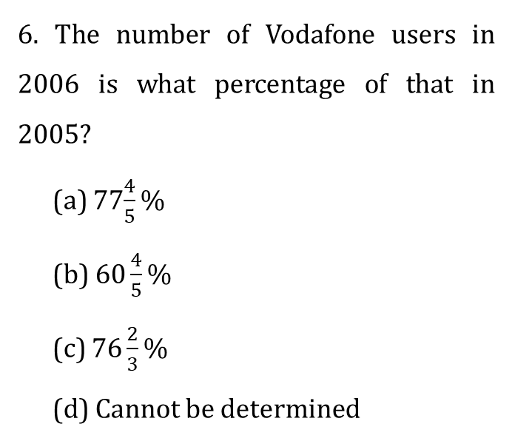
Directions for Q6 to Q10: Answer these questions based on the following pie-charts.
The following are the results of a survey about mobile users in a village in the years 2005 and 2006.
6. The number of Vodafone users in 2006 is what percentage of that in 2005?
(a) 77$\frac{4}{5}\%$
(b) 6$0\frac{4}{5}\%$
(c) 7$6\frac{2}{3}\%$
(d) Cannot be determined

Slide 160
Directions for Q6 to Q10: Answer these questions based on the following pie-charts.
The following are the results of a survey about mobile users in a village in the years 2005 and 2006.
7. The number of Tata indicom users in 2006 is by what percentage more than that in 2005?
(a) 192.8%
(b) 187.5 %
(c) 178.6 %
(d) Cannot be determined
Notes:
17. Ans: [b]
The number of Tata indicom users in 2006
= 115 * 20/100 = 23
The number of Tata indicom users in 2005 = 8
= Required % = (23 – 8)/8 * 100
1500/8
= 187.5%

Slide 161
Directions for Q6 to Q10: Answer these questions based on the following pie-charts.
The following are the results of a survey about mobile users in a village in the years 2005 and 2006.
8. What is the ratio of the number of Idea users in 2005 to the number of Airtel users in 2006?
(a) 16:23
(b) 54:61
(c) 47:59
(d) None of these
Notes:
18. Ans: [a]
Required ratio = 12/[15 * (115/100)]
= 48/69
= 16/23

Slide 162
Directions for Q6 to Q10: Answer these questions based on the following pie-charts.
The following are the results of a survey about mobile users in a village in the years 2005 and 2006.
9. If the total number of mobile users in the village in 2006 was 2300, then proportionately how many people used Airtel in 2005?
(a) 600
(b) 500
(c) 700
(d) 800
Notes:
19. Ans: [b]
= (2300 * 100)/115 = 2000
The number of Airtel users in 2005
= 2000/4 = 500

Slide 163
Directions for Q6 to Q10: Answer these questions based on the following pie-charts.
The following are the results of a survey about mobile users in a village in the years 2005 and 2006.
10. If in 2007, 20% of the Tata indicom users in 2006 no longer use Tata indicom but shifted to ‘Others’, then what is the ratio of the number of people who use ‘Others’ in 2005 to that in 2007 if all other values in 2007 remain the same as in 2006?
(a) 23:10
(b) 12:5
(c) 17:9
(d) None of these
Notes:
20. Ans: [d]
No. Of Tata indicom users in 2006
= (20/100) * 115 = 23
No. Of people who use ‘others’ in 2007 = 10% (115) + 20% (23) = 11.5 + 4.6 = 16.1
Required ratio = 12/16.1 = 120/161

Slide 164
Directions for Q11 to Q15: Answer the questions based on the given information. The following graphs show the total production of wheat, rice and Jowar and the percentage of these food grains exported across the five years.
What is the average quantity of rice that was used for domestic consumption in the given period (in million tonnes)?
(a) 210
(b) 202
(c) 198
(d) 212
Notes:
11. Ans: [b]
Total quantity of rice that was used for domestic consumption
= [(40/100) * 300 + (70/100) * 250 + (55/100) * 450 + (65/100) * 450 + (50/100) * 350)]
= 120 + 175 + 247.5 + 292.5 + 175
= 1010 million tonnes
Required average = 1010/5 = 202 million tonnes

Slide 165
Directions for Q11 to Q15: Answer the questions based on the given information. The following graphs show the total production of wheat, rice and Jowar and the percentage of these food grains exported across the five years.
The total export of wheat in 2004 forms what percentage of the total export of wheat, rice and jowar put together in that year (appprox)?
(a) 26%
(b) 33%
(c) 28%
(d) 32%
Notes:
12. Ans: [d]
Total export of wheat, rice and jowar put together in 2004
= [(65/100) * 300 + (45/100) * 450 + (55/100) * 400] = 617.5
Required % = (195/617.5) * 100 = 32%

Slide 166
Directions for Q11 to Q15: Answer the questions based on the given information. The following graphs show the total production of wheat, rice and Jowar and the percentage of these food grains exported across the five years.
What is the ratio of the total export of wheat, rice and jowar put together in 2002 to that in 2006?
(a) 113:252
(b) 117:137
(c) 13:17
(d) None of these
Notes:
13. Ans: [d]
Total export of wheat, rice and jowar in
2002 = [(40/100) * 200 + (60/100) * 300 + (70/100) * 150] = 365
2006 = [(25/100) * 400 + (50/100) * 350 + (75/100) * 450] = 612.5
The required ratio = 365/612.5 = 146/245

Slide 167
Directions for Q11 to Q15: Answer the questions based on the given information. The following graphs show the total production of wheat, rice and Jowar and the percentage of these food grains exported across the five years.
What is the difference between the total production of wheat and that of rice in the given years (in million tonnes)?
(a) 50
(b) 100
(c) 150
(d) 200
Notes:
14. Ans: [a]
Total production of wheat = 200 + 350 + 300 + 500 + 400 = 1750million tonnes
Total production of rice
= 300 + 250 + 450 + 450 + 350 = 1800 million tonnes
The required difference = 50 million tonnes

Slide 168
Directions for Q11 to Q15: Answer the questions based on the given information. The following graphs show the total production of wheat, rice and Jowar and the percentage of these food grains exported across the five years.
The export of wheat in how many of the given years is less than 37% of the total export of wheat, rice and jowar in the respective years?
(a) 1
(b) 2
(c) 3
(d) 4
Notes:
15. Ans: [c]
% export of wheat in
2002 = (80/365) * 100 ~ 22%
2003 = (175/310) * 100 ~ 56%
2004 = (195/617.5) * 100 ~ 31%
2005 = (350/707.5) * 100 ~ 49%
2006 = (100/612.5) * 100 ~ 16.3%
Export of wheat is less than 37% of total export in 2002, 2004 & 2006.

Slide 169
Directions for Q16 to Q20: Answer the questions based on the graphs given below . The following graph gives the percentage distribution of students in five colleges – A, B, C, D and E studying different streams.
The following bar graph shows the number of students in the arts stream in the five colleges.
How many students are there in college B?
(a) 1260
(b) 1210
(c) 1120
(d) 1140

Slide 170
Directions for Q16 to Q20: Answer the questions based on the graphs given below . The following graph gives the percentage distribution of students in five colleges – A, B, C, D and E studying different streams.
The following bar graph shows the number of students in the arts stream in the five colleges.
How many students study Biology in college C?
(a) 130
(b) 150
(c) 170
(d) 190

Slide 171
Directions for Q16 to Q20: Answer the questions based on the graphs given below . The following graph gives the percentage distribution of students in five colleges – A, B, C, D and E studying different streams.
The following bar graph shows the number of students in the arts stream in the five colleges.
How many students in college E do not study in the Maths stream?
(a) 1750
(b) 1180
(c) 960
(d) 840

Slide 172
Directions for Q16 to Q20: Answer the questions based on the graphs given below . The following graph gives the percentage distribution of students in five colleges – A, B, C, D and E studying different streams.
The following bar graph shows the number of students in the arts stream in the five colleges.
In which college is the total number of students the highest?
(a) B
(b) C
(c) D
(d) E

Slide 173
Directions for Q16 to Q20: Answer the questions based on the graphs given below . The following graph gives the percentage distribution of students in five colleges – A, B, C, D and E studying different streams.
The following bar graph shows the number of students in the arts stream in the five colleges.
What percentage of the students in all the colleges put together study in the Maths stream (approx)?
(a) 20% (b) 30%
(c) 40% (d) 35%

Slide 174
End of Session – 7
Thank You

Slide 175
SESSION – 8 DATA INTERPRETATION – CASELETS

Slide 176
Directions for Q1 to Q5: Read the following information and answer the questions given below.
Arun has bought 10 acres of land for Rs.250000 in 2011. That year he cultivated Sugarcane and Soya bean in the 10 acres with the ratio of area under sugarcane and soya bean being 5:4. The profit obtained from Sugarcane and Soya bean was in the ratio 3:2 with the total profit being Rs.58500. This was 15% of the amount he invested in cultivation that year. The next year he again cultivated Sugarcane and Soya bean, with the areas being same as before and reaped a profit of Rs.66000 in total with that from Sugarcane and Soya bean being the ratio 8:7 but his return on his investment that year was only 14%.
1. What is the amount invested by Arun for cultivation in 2011?
(a) Rs.356000 (b) Rs.374800 (c) Rs.380000 (d) Rs.390000

Slide 177
Directions for Q1 to Q5: Read the following information and answer the questions given below.
Arun has bought 10 acres of land for Rs.250000 in 2011. That year he cultivated Sugarcane and Soya bean in the 10 acres with the ratio of area under sugarcane and soya bean being 5:4. The profit obtained from Sugarcane and Soya bean was in the ratio 3:2 with the total profit being Rs.58500. This was 15% of the amount he invested in cultivation that year. The next year he again cultivated Sugarcane and Soya bean, with the areas being same as before and reaped a profit of Rs.66000 in total with that from Sugarcane and Soya bean being the ratio 8:7 but his return on his investment that year was only 14%.
2. What is the profit obtained by Arun by cultivating Sugarcane in 2011?
(a) Rs.43800 (b) Rs.35100 (c) Rs.36200 (d) None of these

Slide 178
Directions for Q1 to Q5: Read the following information and answer the questions given below.
Arun has bought 10 acres of land for Rs.250000 in 2011. That year he cultivated Sugarcane and Soya bean in the 10 acres with the ratio of area under sugarcane and soya bean being 5:4. The profit obtained from Sugarcane and Soya bean was in the ratio 3:2 with the total profit being Rs.58500. This was 15% of the amount he invested in cultivation that year. The next year he again cultivated Sugarcane and Soya bean, with the areas being same as before and reaped a profit of Rs.66000 in total with that from Sugarcane and Soya bean being the ratio 8:7 but his return on his investment that year was only 14%.
3. What is the ratio of the profit obtained from Sugarcane and Soya bean in the two years together?
(a) 89:79 (b) 167:211
(c) 703:542 (d) None of these

Slide 179
Directions for Q1 to Q5: Read the following information and answer the questions given below.
Arun has bought 10 acres of land for Rs.250000 in 2011. That year he cultivated Sugarcane and Soya bean in the 10 acres with the ratio of area under sugarcane and soya bean being 5:4. The profit obtained from Sugarcane and Soya bean was in the ratio 3:2 with the total profit being Rs.58500. This was 15% of the amount he invested in cultivation that year. The next year he again cultivated Sugarcane and Soya bean, with the areas being same as before and reaped a profit of Rs.66000 in total with that from Sugarcane and Soya bean being the ratio 8:7 but his return on his investment that year was only 14%.
4. What is the approximate amount invested by Arun for cultivation in 2012?
(a) Rs.428500 (b) Rs.471420 (c) Rs.495300 (d) Rs.518650

Slide 180
Directions for Q1 to Q5: Read the following information and answer the questions given below.
Arun has bought 10 acres of land for Rs.250000 in 2011. That year he cultivated Sugarcane and Soya bean in the 10 acres with the ratio of area under sugarcane and soya bean being 5:4. The profit obtained from Sugarcane and Soya bean was in the ratio 3:2 with the total profit being Rs.58500. This was 15% of the amount he invested in cultivation that year. The next year he again cultivated Sugarcane and Soya bean, with the areas being same as before and reaped a profit of Rs.66000 in total with that from Sugarcane and Soya bean being the ratio 8:7 but his return on his investment that year was only 14%.
5. What is the approximate percentage of Soya bean over Sugarcane in 2011?
(a) 66% (b) 70% (c) 82% (d) 56%

Slide 181
Directions for Q6 to Q10: Read the following information and answer the questions given below.
In a ship there are 1200 passengers, 18% of the total number of passengers is from Britain. Two-fifth of the total number of passengers is from South Africa, 6% of the total number of passengers is from Madagascar. Remaining number of passengers is from India. 25% of the number of passengers from Britain is females. Half of the numbers of passengers from South Africa are male. There is no female passenger from Madagascar. Two-third of the number of passengers from India are females.
6. What is the ratio of the number of passengers from Madagascar, number of female passengers from South Africa and the total number of passenger from India?
(a) 2:5:18 (b) 3:10:18 (c) 3:11:18 (d) 2:18:5

Slide 182
Directions for Q6 to Q10: Read the following information and answer the questions given below.
In a ship there are 1200 passengers, 18% of the total number of passengers is from Britain. Two-fifth of the total number of passengers is from South Africa, 6% of the total number of passengers is from Madagascar. Remaining number of passengers is from India. 25% of the number of passengers from Britain is females. Half of the numbers of passengers from South Africa are male. There is no female passenger from Madagascar. Two-third of the number of passengers from India are females.
7. The number of male passengers from South Africa is approximately what percentage of the total number of passenger from Britain
(a) 111 (b) 115 (c) 120 (d) 125

Slide 183
Directions for Q6 to Q10: Read the following information and answer the questions given below.
In a ship there are 1200 passengers, 18% of the total number of passengers is from Britain. Two-fifth of the total number of passengers is from South Africa, 6% of the total number of passengers is from Madagascar. Remaining number of passengers is from India. 25% of the number of passengers from Britain is females. Half of the numbers of passengers from South Africa are male. There is no female passenger from Madagascar. Two-third of the number of passengers from India are females.
8. What is the average number of male passengers from all the four countries?
(a) 154.5 (b) 164.5 (c) 145 (d) 164

Slide 184
Directions for Q6 to Q10: Read the following information and answer the questions given below.
In a ship there are 1200 passengers, 18% of the total number of passengers is from Britain. Two-fifth of the total number of passengers is from South Africa, 6% of the total number of passengers is from Madagascar. Remaining number of passengers is from India. 25% of the number of passengers from Britain is females. Half of the numbers of passengers from South Africa are male. There is no female passenger from Madagascar. Two-third of the number of passengers from India are females.
9. What is the difference between the number of male passengers from Madagascar and the number of male passengers from India?
(a) 64 (b) 82 (c) 74 (d) 72

Slide 185
Directions for Q6 to Q10: Read the following information and answer the questions given below.
In a ship there are 1200 passengers, 18% of the total number of passengers is from Britain. Two-fifth of the total number of passengers is from South Africa, 6% of the total number of passengers is from Madagascar. Remaining number of passengers is from India. 25% of the number of passengers from Britain is females. Half of the numbers of passengers from South Africa are male. There is no female passenger from Madagascar. Two-third of the number of passengers from India are females.
10. What is the total number of male from Britain passengers and female passengers from India together?
(a) 340 (b) 420 (c) 350 (d) 450

Slide 186
Directions for Q11 to Q15: Answer the questions based on the information given below.
A survey was made on the games played by 170 young persons of a colony to decide which of the three games they played was the most popular.
The survey found that 80 played cricket, 14 played cricket and chess, 76 played badminton, 18 played badminton and cricket only, 82 played chess, 22 played chess and badminton only, 17 played all the three games.
From the above information, answer the questions 9 to 13 given below.
11. The number of persons who did not play any of the games is
(a) 20 (b) 30 (c) 25 (d) 15

Slide 187
Directions for Q11 to Q15: Answer the questions based on the information given below.
A survey was made on the games played by 170 young persons of a colony to decide which of the three games they played was the most popular.
The survey found that 80 played cricket, 14 played cricket and chess, 76 played badminton, 18 played badminton and cricket only, 82 played chess, 22 played chess and badminton only, 17 played all the three games.
From the above information, answer the questions 9 to 13 given below.
12. Which is the most popular game of the three?
(a) Badminton (b) Cricket
(c) Chess (d) Data not adequate

Slide 188
Directions for Q11 to Q15: Answer the questions based on the information given below.
A survey was made on the games played by 170 young persons of a colony to decide which of the three games they played was the most popular.
The survey found that 80 played cricket, 14 played cricket and chess, 76 played badminton, 18 played badminton and cricket only, 82 played chess, 22 played chess and badminton only, 17 played all the three games.
From the above information, answer the questions 9 to 13 given below.
13. What is the percent of persons who play Cricket?
(a) 57.2% (b) 53.3% (c) 47% (d) 39.8%

Slide 189
Directions for Q11 to Q15: Answer the questions based on the information given below.
A survey was made on the games played by 170 young persons of a colony to decide which of the three games they played was the most popular.
The survey found that 80 played cricket, 14 played cricket and chess, 76 played badminton, 18 played badminton and cricket only, 82 played chess, 22 played chess and badminton only, 17 played all the three games.
From the above information, answer the questions 9 to 13 given below.
14. What is the difference in the number of persons, who play one game and those who play two games?
(a) 19 (b) 25 (c) 31 (d) 27

Slide 190
Directions for Q11 to Q15: Answer the questions based on the information given below.
A survey was made on the games played by 170 young persons of a colony to decide which of the three games they played was the most popular.
The survey found that 80 played cricket, 14 played cricket and chess, 76 played badminton, 18 played badminton and cricket only, 82 played chess, 22 played chess and badminton only, 17 played all the three games.
From the above information, answer the questions 9 to 13 given below.
15. What is the percent difference of the number of persons who play chess and those who play badminton?
(a) 6.5 (b) 4.5 (c) 5.5 (d) 3.5

Slide 191
Directions for Q16 to Q20: ABC is a firm manufacturing engineering components. Its performance for the five year period for 2011 to 2016 was widely fluctuating due to stiff competition and also to their own factors. Its ratio of expenditure to income in 2011 was 0.5 which went up to 0.75 in 2012 due to some labour problem. However, after an agreement with the labour union, the situation improved and the ratio came down to 0.4 in 2013 and an all time low to 0.3 in 2014. However, the situation started becoming unfavourable due to slump in the market and the company ended the year 2015 with a high ratio of 1.1.
Given the above information, answer the following questions.
16. If the income in 2012 was Rs.320 crores, then what is the expenditure for the same year (in Rs. Crores)?
(a) 280 (b) 340 (c) 240 (d) 205

Slide 192
Directions for Q16 to Q20: ABC is a firm manufacturing engineering components. Its performance for the five year period for 2011 to 2016 was widely fluctuating due to stiff competition and also to their own factors. Its ratio of expenditure to income in 2011 was 0.5 which went up to 0.75 in 2012 due to some labour problem. However, after an agreement with the labour union, the situation improved and the ratio came down to 0.4 in 2013 and an all time low to 0.3 in 2014. However, the situation started becoming unfavourable due to slump in the market and the company ended the year 2015 with a high ratio of 1.1.
Given the above information, answer the following questions.
17. If the income had been 20% more in 2013 what would have been the ratio of expenditure to income?
(a) 0.25 (b) 0.33 (c) 0.45 (d) 0.38

Slide 193
Directions for Q16 to Q20: ABC is a firm manufacturing engineering components. Its performance for the five year period for 2011 to 2016 was widely fluctuating due to stiff competition and also to their own factors. Its ratio of expenditure to income in 2011 was 0.5 which went up to 0.75 in 2012 due to some labour problem. However, after an agreement with the labour union, the situation improved and the ratio came down to 0.4 in 2013 and an all time low to 0.3 in 2014. However, the situation started becoming unfavourable due to slump in the market and the company ended the year 2015 with a high ratio of 1.1.
Given the above information, answer the following questions.
18.In which year the company incurred a loss?
(a) 2012 (b) 2015 (c) 2013 (d) 2014

Slide 194
Directions for Q16 to Q20: ABC is a firm manufacturing engineering components. Its performance for the five year period for 2011 to 2016 was widely fluctuating due to stiff competition and also to their own factors. Its ratio of expenditure to income in 2011 was 0.5 which went up to 0.75 in 2012 due to some labour problem. However, after an agreement with the labour union, the situation improved and the ratio came down to 0.4 in 2013 and an all time low to 0.3 in 2014. However, the situation started becoming unfavourable due to slump in the market and the company ended the year 2015 with a high ratio of 1.1.
Given the above information, answer the following questions.
19. If the earnings in 2016 was Rs.480 crores, then what is the ratio of expenditure to income in 2016?
(a) 0.6 (b) 0.7
(c) 0.45 (d) Cannot be determined

Slide 195
Directions for Q16 to Q20: ABC is a firm manufacturing engineering components. Its performance for the five year period for 2011 to 2016 was widely fluctuating due to stiff competition and also to their own factors. Its ratio of expenditure to income in 2011 was 0.5 which went up to 0.75 in 2012 due to some labour problem. However, after an agreement with the labour union, the situation improved and the ratio came down to 0.4 in 2013 and an all time low to 0.3 in 2014. However, the situation started becoming unfavourable due to slump in the market and the company ended the year 2015 with a high ratio of 1.1.
Given the above information, answer the following questions.
20. If the income in 2016 were Rs.480 crores and the expenditure was Rs.360 crore, what is the percent change in the ratio of expenditure to income compared to the preceding year?
(a) 28% (b) 22% (c) 38% (d) 32%

Slide 196
End of Session – 8
Thank You

Slide 197
Session – 9 DATA SUFFICIENCY - I

Slide 198
Directions for Q1 to Q20: Each of the questions below consists of a question and two statements numbered I and II given below it. You have to decide whether the data provided in the statements are sufficient to answer the question. Read both the statements and give answer as
(A) If the data in Statement I alone is sufficient to answer the question, while the data in Statement II alone is not sufficient to answer the question
(B) If the data in Statement II alone is sufficient to answer the question, while the data in Statement I alone is not sufficient to answer the question.
(C) If the data in each statement alone is sufficient to answer the question.
(D) If the data in both the Statement I and II are not sufficient to answer the question.
(E) If the data in both the Statements I and II together are necessary to answer the question.
1. Among P, Q, R, S and T, which bag is the lightest?
I. P is heavier than Q, R is as heavy as Q, T is lighter than R.
II. S is lighter than Q but heavier than T.

Slide 199
Directions for Q1 to Q20: Each of the questions below consists of a question and two statements numbered I and II given below it. You have to decide whether the data provided in the statements are sufficient to answer the question. Read both the statements and give answer as
(A) If the data in Statement I alone is sufficient to answer the question, while the data in Statement II alone is not sufficient to answer the question
(B) If the data in Statement II alone is sufficient to answer the question, while the data in Statement I alone is not sufficient to answer the question.
(C) If the data in each statement alone is sufficient to answer the question.
(D) If the data in both the Statement I and II are not sufficient to answer the question.
(E) If the data in both the Statements I and II together are necessary to answer the question.
2. Is X the wife of Y?
I. X’s daughter M is the only sister of R. R is the son of Y.
II. The mother of Y has only one grandson R.

Slide 200
Directions for Q1 to Q20: Each of the questions below consists of a question and two statements numbered I and II given below it. You have to decide whether the data provided in the statements are sufficient to answer the question. Read both the statements and give answer as
(A) If the data in Statement I alone is sufficient to answer the question, while the data in Statement II alone is not sufficient to answer the question
(B) If the data in Statement II alone is sufficient to answer the question, while the data in Statement I alone is not sufficient to answer the question.
(C) If the data in each statement alone is sufficient to answer the question.
(D) If the data in both the Statement I and II are not sufficient to answer the question.
(E) If the data in both the Statements I and II together are necessary to answer the question.
3. On which day of the week did Sourav visit Delhi?
I. Sourav visited Delhi after Monday, but before Thursday, but not on an odd day of the week.
II. Sourav visited Delhi before Friday, but after Monday.

Slide 201
Directions for Q1 to Q20: Each of the questions below consists of a question and two statements numbered I and II given below it. You have to decide whether the data provided in the statements are sufficient to answer the question. Read both the statements and give answer as
(A) If the data in Statement I alone is sufficient to answer the question, while the data in Statement II alone is not sufficient to answer the question
(B) If the data in Statement II alone is sufficient to answer the question, while the data in Statement I alone is not sufficient to answer the question.
(C) If the data in each statement alone is sufficient to answer the question.
(D) If the data in both the Statement I and II are not sufficient to answer the question.
(E) If the data in both the Statements I and II together are necessary to answer the question.
4. Chandra and Mauli’s income is in the ratio of 4:3. What is the income of Chandra?
I. Mauli’s income is 75% of Chandra’s.
II. Mauli’s income is Rs.4500.

Slide 202
Directions for Q1 to Q20: Each of the questions below consists of a question and two statements numbered I and II given below it. You have to decide whether the data provided in the statements are sufficient to answer the question. Read both the statements and give answer as
(A) If the data in Statement I alone is sufficient to answer the question, while the data in Statement II alone is not sufficient to answer the question
(B) If the data in Statement II alone is sufficient to answer the question, while the data in Statement I alone is not sufficient to answer the question.
(C) If the data in each statement alone is sufficient to answer the question.
(D) If the data in both the Statement I and II are not sufficient to answer the question.
(E) If the data in both the Statements I and II together are necessary to answer the question.
5. The value of a kit depends upon the number of leaves in the kit. How many leaves are there in the kit?
I. Medium size kit values Rs.850.
II. There are 55 leaves in smallest sized kit.

Slide 203
Directions for Q1 to Q20: Each of the questions below consists of a question and two statements numbered I and II given below it. You have to decide whether the data provided in the statements are sufficient to answer the question. Read both the statements and give answer as
(A) If the data in Statement I alone is sufficient to answer the question, while the data in Statement II alone is not sufficient to answer the question
(B) If the data in Statement II alone is sufficient to answer the question, while the data in Statement I alone is not sufficient to answer the question.
(C) If the data in each statement alone is sufficient to answer the question.
(D) If the data in both the Statement I and II are not sufficient to answer the question.
(E) If the data in both the Statements I and II together are necessary to answer the question.
6. What is the value of x?
I. x – y = 5
II. x + y = 15

Slide 204
Directions for Q1 to Q20: Each of the questions below consists of a question and two statements numbered I and II given below it. You have to decide whether the data provided in the statements are sufficient to answer the question. Read both the statements and give answer as
(A) If the data in Statement I alone is sufficient to answer the question, while the data in Statement II alone is not sufficient to answer the question
(B) If the data in Statement II alone is sufficient to answer the question, while the data in Statement I alone is not sufficient to answer the question.
(C) If the data in each statement alone is sufficient to answer the question.
(D) If the data in both the Statement I and II are not sufficient to answer the question.
(E) If the data in both the Statements I and II together are necessary to answer the question.
7. How many Hindi students got more than 40 marks?
70% of total students got 40% marks.
20% of the students securing 40% marks are Hindi students.

Slide 205
Directions for Q1 to Q20: Each of the questions below consists of a question and two statements numbered I and II given below it. You have to decide whether the data provided in the statements are sufficient to answer the question. Read both the statements and give answer as
(A) If the data in Statement I alone is sufficient to answer the question, while the data in Statement II alone is not sufficient to answer the question
(B) If the data in Statement II alone is sufficient to answer the question, while the data in Statement I alone is not sufficient to answer the question.
(C) If the data in each statement alone is sufficient to answer the question.
(D) If the data in both the Statement I and II are not sufficient to answer the question.
(E) If the data in both the Statements I and II together are necessary to answer the question.
8. Does mental labour reduce weight?
Mental labour is more hazardous than physical labour.
Mental labour destroys both strength and concentration.

Slide 206
Directions for Q1 to Q20: Each of the questions below consists of a question and two statements numbered I and II given below it. You have to decide whether the data provided in the statements are sufficient to answer the question. Read both the statements and give answer as
(A) If the data in Statement I alone is sufficient to answer the question, while the data in Statement II alone is not sufficient to answer the question
(B) If the data in Statement II alone is sufficient to answer the question, while the data in Statement I alone is not sufficient to answer the question.
(C) If the data in each statement alone is sufficient to answer the question.
(D) If the data in both the Statement I and II are not sufficient to answer the question.
(E) If the data in both the Statements I and II together are necessary to answer the question.
9. On which day is M’s birthday?
M’s birthday is not on a working day.
M works on Sundays.

Slide 207
Directions for Q1 to Q20: Each of the questions below consists of a question and two statements numbered I and II given below it. You have to decide whether the data provided in the statements are sufficient to answer the question. Read both the statements and give answer as
(A) If the data in Statement I alone is sufficient to answer the question, while the data in Statement II alone is not sufficient to answer the question
(B) If the data in Statement II alone is sufficient to answer the question, while the data in Statement I alone is not sufficient to answer the question.
(C) If the data in each statement alone is sufficient to answer the question.
(D) If the data in both the Statement I and II are not sufficient to answer the question.
(E) If the data in both the Statements I and II together are necessary to answer the question.
10. How far is X from Z?
X is 2 km from Y.
Y is 5 km from Z.

Slide 208
Directions for Q1 to Q20: Each of the questions below consists of a question and two statements numbered I and II given below it. You have to decide whether the data provided in the statements are sufficient to answer the question. Read both the statements and give answer as
(A) If the data in Statement I alone is sufficient to answer the question, while the data in Statement II alone is not sufficient to answer the question
(B) If the data in Statement II alone is sufficient to answer the question, while the data in Statement I alone is not sufficient to answer the question.
(C) If the data in each statement alone is sufficient to answer the question.
(D) If the data in both the Statement I and II are not sufficient to answer the question.
(E) If the data in both the Statements I and II together are necessary to answer the question.
11. Sneha borrowed a certain amount at compound interest and returned the amount with interest in two equal installments. What was the amount borrowed?
The rate of interest was 10% per annum.
Each installment was Rs.1210.

Slide 209
Directions for Q1 to Q20: Each of the questions below consists of a question and two statements numbered I and II given below it. You have to decide whether the data provided in the statements are sufficient to answer the question. Read both the statements and give answer as
(A) If the data in Statement I alone is sufficient to answer the question, while the data in Statement II alone is not sufficient to answer the question
(B) If the data in Statement II alone is sufficient to answer the question, while the data in Statement I alone is not sufficient to answer the question.
(C) If the data in each statement alone is sufficient to answer the question.
(D) If the data in both the Statement I and II are not sufficient to answer the question.
(E) If the data in both the Statements I and II together are necessary to answer the question.
12. If a and b are non-negative numbers, is (a + b) greater than ab?
a=b
a + b is greater than a² + b²

Slide 210
Directions for Q1 to Q20: Each of the questions below consists of a question and two statements numbered I and II given below it. You have to decide whether the data provided in the statements are sufficient to answer the question. Read both the statements and give answer as
(A) If the data in Statement I alone is sufficient to answer the question, while the data in Statement II alone is not sufficient to answer the question
(B) If the data in Statement II alone is sufficient to answer the question, while the data in Statement I alone is not sufficient to answer the question.
(C) If the data in each statement alone is sufficient to answer the question.
(D) If the data in both the Statement I and II are not sufficient to answer the question.
(E) If the data in both the Statements I and II together are necessary to answer the question.
13. Is the average of the largest and the smallest of four given numbers greater than the average of the four numbers?
The difference between the largest and the second largest number is greater than the difference between the second smallest and the smallest number.
The difference between the largest and the second largest is less than the difference between the second largest and the second smallest number.

Slide 211
Directions for Q1 to Q20: Each of the questions below consists of a question and two statements numbered I and II given below it. You have to decide whether the data provided in the statements are sufficient to answer the question. Read both the statements and give answer as
(A) If the data in Statement I alone is sufficient to answer the question, while the data in Statement II alone is not sufficient to answer the question
(B) If the data in Statement II alone is sufficient to answer the question, while the data in Statement I alone is not sufficient to answer the question.
(C) If the data in each statement alone is sufficient to answer the question.
(D) If the data in both the Statement I and II are not sufficient to answer the question.
(E) If the data in both the Statements I and II together are necessary to answer the question.
14. Tarak is standing 2 steps to the left of a red mark and 3 steps to the right of a blue mark. He tosses a coin. If it comes up heads, he moves one step to the right; otherwise he moves one step to the left. He keeps doing this until he reaches one of the two marks and then he stops. At which mark does he stop?
He stops after 21 coin tosses.
He obtains three more tails than heads.

Slide 212
Directions for Q1 to Q20: Each of the questions below consists of a question and two statements numbered I and II given below it. You have to decide whether the data provided in the statements are sufficient to answer the question. Read both the statements and give answer as
(A) If the data in Statement I alone is sufficient to answer the question, while the data in Statement II alone is not sufficient to answer the question
(B) If the data in Statement II alone is sufficient to answer the question, while the data in Statement I alone is not sufficient to answer the question.
(C) If the data in each statement alone is sufficient to answer the question.
(D) If the data in both the Statement I and II are not sufficient to answer the question.
(E) If the data in both the Statements I and II together are necessary to answer the question.
15. Ravi spent less than Rs.75 to buy one kilogram each of potato, onion and gourd. Which one of the three vegetables bought was the costliest?
2 kg potato and 1 kg gourd cost less than 1 kg potato and 2 kg gourd.
1 kg potato and 2 kg onion together cost the same as 1 kg onion and 2 kg gourd.

Slide 213
Directions for Q1 to Q20: Each of the questions below consists of a question and two statements numbered I and II given below it. You have to decide whether the data provided in the statements are sufficient to answer the question. Read both the statements and give answer as
(A) If the data in Statement I alone is sufficient to answer the question, while the data in Statement II alone is not sufficient to answer the question
(B) If the data in Statement II alone is sufficient to answer the question, while the data in Statement I alone is not sufficient to answer the question.
(C) If the data in each statement alone is sufficient to answer the question.
(D) If the data in both the Statement I and II are not sufficient to answer the question.
(E) If the data in both the Statements I and II together are necessary to answer the question.
16. What is the value of x?
x² = 4
x < 0

Slide 214
Directions for Q1 to Q20: Each of the questions below consists of a question and two statements numbered I and II given below it. You have to decide whether the data provided in the statements are sufficient to answer the question. Read both the statements and give answer as
(A) If the data in Statement I alone is sufficient to answer the question, while the data in Statement II alone is not sufficient to answer the question
(B) If the data in Statement II alone is sufficient to answer the question, while the data in Statement I alone is not sufficient to answer the question.
(C) If the data in each statement alone is sufficient to answer the question.
(D) If the data in both the Statement I and II are not sufficient to answer the question.
(E) If the data in both the Statements I and II together are necessary to answer the question.
17. What is the number x?
The LCM of x and 18 is 36.
The HCF of x and 18 is 2.

Slide 215
Directions for Q1 to Q20: Each of the questions below consists of a question and two statements numbered I and II given below it. You have to decide whether the data provided in the statements are sufficient to answer the question. Read both the statements and give answer as
(A) If the data in Statement I alone is sufficient to answer the question, while the data in Statement II alone is not sufficient to answer the question
(B) If the data in Statement II alone is sufficient to answer the question, while the data in Statement I alone is not sufficient to answer the question.
(C) If the data in each statement alone is sufficient to answer the question.
(D) If the data in both the Statement I and II are not sufficient to answer the question.
(E) If the data in both the Statements I and II together are necessary to answer the question.
18. What will be the remainder if x is divided by 60?
x is exactly divisible by 5.
x is exactly divisible by 12.

Slide 216
Directions for Q1 to Q20: Each of the questions below consists of a question and two statements numbered I and II given below it. You have to decide whether the data provided in the statements are sufficient to answer the question. Read both the statements and give answer as
(A) If the data in Statement I alone is sufficient to answer the question, while the data in Statement II alone is not sufficient to answer the question
(B) If the data in Statement II alone is sufficient to answer the question, while the data in Statement I alone is not sufficient to answer the question.
(C) If the data in each statement alone is sufficient to answer the question.
(D) If the data in both the Statement I and II are not sufficient to answer the question.
(E) If the data in both the Statements I and II together are necessary to answer the question.
19. Is the integer n divisible by 9? ( Given that n is a two digit number)
When n is divided by 3, the remainder is 2.
When n is divided by 7, the remainder is 1.

Slide 217
Directions for Q1 to Q20: Each of the questions below consists of a question and two statements numbered I and II given below it. You have to decide whether the data provided in the statements are sufficient to answer the question. Read both the statements and give answer as
(A) If the data in Statement I alone is sufficient to answer the question, while the data in Statement II alone is not sufficient to answer the question
(B) If the data in Statement II alone is sufficient to answer the question, while the data in Statement I alone is not sufficient to answer the question.
(C) If the data in each statement alone is sufficient to answer the question.
(D) If the data in both the Statement I and II are not sufficient to answer the question.
(E) If the data in both the Statements I and II together are necessary to answer the question.
20. In how many days will A alone do a job?
A and B can do half of the job in 12 days.
B alone can do it in 30 days.

Slide 218
End of Session - 9 Thank You…

Slide 219
Session – 10 DATA SUFFICIENCY - II

Slide 220
Directions for Q1 to Q20: Each problem consists of a question and two statements, labelled (1) and (2), in which certain data are given. You have to decide whether the data given in the statements are sufficient for answering the question.
Mark Choice (1) If statement 1 alone is sufficient, but statement 2 alone is not sufficient to answer the question;
Choice (2) If statement 2 alone is sufficient, but statement 1 alone is not sufficient to answer the question;
Choice (3) If both the statement (1) and (2) together are sufficient to answer the question but neither statement alone is sufficient;
Choice (4) If each statement alone is sufficient to answer the question;
Choice (5) If both the statement (1) and (2) together are not sufficient to answer the question and additional data specific to the problem are needed.

Slide 221
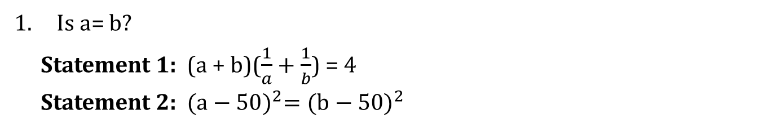
Is a= b?
Statement 1: (a + b)($\frac{1}{a}+\frac{1}{b}$) = 4
Statement 2: ${(a−50)}^{2}={(b−50)}^{2}$
Notes:
1. Ans: [1]
(a + b) ($\frac{1}{a}+\frac{1}{b}$) = 4
=> 1 + 1 + $\frac{a}{b}+\frac{b}{a}$ = 4
=> $\frac{a}{b}+\frac{b}{a}$ = 2
This is possible when a = b. Hence statement 1 alone is sufficient.
Statement 2 (a – 50)² = (b – 50)² . We cannot say if a = b in this case. Take for example, let a = 100 and b = 0. Then (a – 50)² = (100 – 50)² = 50² = 2500
And (b – 50)² = (0 – 50)² = 50² = 2500
Hence, statement 1 alone is sufficient and statement 2 alone is not sufficient.

Slide 222
If a salesman received a commission of 3% of the sales that he has booked in a month, what was the sales booked by the salesman in November 2003?
Statement 1: The sales booked by the salesman in the month of November 2003 after subtracting the salesman’s commission was Rs.245,000.
Statement 2: The value of the sales booked by the salesman in the month of November 2003 was 125 percent of the original purchase price of Rs.225,000.
Notes:
2. Ans: [4]
From statement (1), we know that the sales value after the salesman’s commission. If his commission is 3% of the sales booked. Then the net sales value is 100 – 3 = 97% of the sales booked.
From statement (1), we know that 97% of sales booked = Rs.245,000. So we can find out the sales booked. Statement (1) alone is sufficient.
From statement (2), we know that the original cost of the products is Rs.225,000. We know the sales booked = 1.25 * 225,000. Hence, statement (2) is also sufficient.
As each of the two statements are independently sufficient to answer the question, choice (4) is the best answer.

Slide 223
If only people who paid the deposits attended the Management Seminar, how many people attended this year?
Statement 1: 70 people sent in deposits to attend the Management Seminar this year.
Statement 2: 60 percent of the people who sent deposits to attend the Management Seminar this year actually went.
Notes:
3. Ans: [3]
The statement provides information about the number of people who sent in deposits this year. However, not all those who sent in deposits may have attended the seminar.
Without knowing whether all of them attended or only a fraction of those who sent the deposit attended, we will not be able to find the answer.
Statement (1) alone is not sufficient.
The moment we realize that statement (1) is not sufficient, we can eliminate choices 1 and 4.
We can narrow down our choices to 2, 3 and 5.
Remember: When you are evaluating statement (2) alone, do not recall information that you read in statement (1).
60 percent of the people who sent deposits attended.
If 1000 sent in their deposits, the answer to the question will be 600.
If 100 sent in their deposits, the answer to the question will be 60.
We are not getting a unique value for the number of people who attended the seminar from this statement.
Statement (2) alone is not sufficient.
We can eliminate choice 2.
The answer narrows down to 3 or 5.
Using the information in the two statements, we can deduce that 60% of 70 = 42 people attended the seminar.
Using the two statements, we could get a unique answer to the question.
Hence, the correct answer is Choice 3. Both statements are needed to answer the question.

Slide 224
A car drives along a straight road from A to B, going through Madurai along the way. What is the total distance travelled by the car from A to B?
Statement 1: The distance from A to C is 3/5 of the entire distance.
Statement 2: The distance from C to B is 12 km.
Notes:
4. Ans: [3]
A to C is 3/5th of the total distance.
Without knowing the distance between A and C, we cannot equate the proportion to the actual distance and compute the total distance.
For instance, if the distance between A and C is 300 km, the total distance will be 500 km. Conversely, if the distance between A and Madurai is 600 km, the total distance will be 1000 km.
The bottom line is that we cannot find the total distance from the information given in statement (1).
Statement (1) alone is not sufficient.
The moment we realize that statement (1) is not sufficient, we can eliminate choices 1 and 4.
We can narrow down our choices to 2, 3 and 5.
Remember: When you are evaluating statement (2) alone, do not recall information that you read in statement (1).
We know the distance for one part of the journey – between C and B.
However, from statement (2) we do not know the distance for the other part – distance between A and C
We are not able to determine the total distance using statement (2) alone.
Statement (2) alone is not sufficient.
We can eliminate choice 2.
The answer narrows down to 3 or 5.
From statement (1) we can deduce that the distance between C and B is 2/5th of the total distance.
From statement (2) we know that the distance between C and B is 12 km.
Equating the two we will be able to get a unique answer for the total distance.
Note: You do not have to find the distance in a data sufficiency question. You just need to be sure that you can find a unique answer.
Nevertheless, let us find the distance before wrapping the question
If the total distance is x, then 2/5x = 12
Or x = 30 km
Using statements (1) and (2) together, we could find a unique answer.
Hence, the correct answer is Choice 3. Both statements are needed to answer the question.

Slide 225
5. Hari purchased 18 cans of soda, some of which contained diet soda. How many of the cans did not contain diet soda?
Statement 1: Of the cans Hari purchased, the number containing diet soda is equal to the number not containing diet soda.
Statement 2: Of the cans Hari purchased, the number of cans containing diet soda is odd.
Notes:
5. Ans: [4]
From the question stem we know that Hari purchased 18 cans.
If the number of cans containing diet soda is equal to the number not containing diet soda, we can deduce that 9 cans do not contain diet soda.
We could find a unique answer using statement (1) alone.
Statement (1) alone is sufficient.
The moment we realize that statement (1) is sufficient, we can narrow down our choices to 1 or 4.
To determine whether the answer is choice 1 or choice 4, we need to evaluate statement (2). Remember that you have to evaluate statement (2) even if statement (1) is sufficient.
Remember: When you are evaluating statement (2) alone, please do not recall information that you read in statement (1). Anything said about the number of cans in statement (1) should not be used while evaluating statement (2).
The number of cans containing diet soda is odd. The number could be 1 or 3 or 5 or any odd number up to 17.
Correspondingly, the number of cans not containing diet soda will be an odd number down from 17 to 1.
We cannot find a unique value for the number of cans not containing diet soda from the information given in statement (2).
Statement (2) alone is also sufficient. Hence, choice (4) is the answer.

Slide 226
6. In 2000, was the number of people in city X greater than three times the number of people in city Y?
Statement 1: In 2000, there were approximately 1.1 million more people in city X than in city Y.
Statement 2: In 2000, the 300,000 Hindus in city X made up for 20 percent of its population and the 141,000 Buddhists in city Y made up for 30 percent of its population.
Notes:
6. Ans: [2]
Statement 1: If city Y had a population of 0.1 million, then city X will have a population of 1.2 million. The population of city X will be greater than 3 times the population of city Y. The answer to the question is yes.
Statement 2: Alternatively, if city Y had a population of 4 million, city X will have a population of 5.1 million. The population of city X is not greater than 3 times the population of city Y. The answer to the question is no.
The answer is yes for some values of the population of Y and the answer is no for other values of the population of Y.
We could not find a unique answer using statement (1) alone.
Statement (1) alone is not sufficient.
If statement (1) alone is not sufficient, we can eliminate choices 1 and 4.
Choices narrow down to 2, 3, or 5.
Remember: When you are evaluating statement (2) alone, do not recall information that you read in statement (1). Anything said about the population of city X or city Y in statement (1) should not be used while evaluating statement (2).
300,000 Hindus in city X made up for 20% of its population. So, we can deduce that the population of city X in 2000 was 1,500,000.
141,000 Buddhists in city Y made up for 30% of its population. So, we can deduce that the population of city Y in 2000 was 470,000.
Using statement (2) we were able to determine the population of the two cities. With this information, we can conclusively answer the question.
Statement (2) alone is sufficient. Hence, choice (2) is the answer.

Slide 227
7. What is the surface area of the rectangular solid y?
Statement 1: The dimensions of one face of the rectangular solid y are 2 by 3.
Statement 2: The area of another face of the rectangular solid y is 6.
Notes:
7. Ans: [5]
Essentially, we have two out of the 3 dimensions required to find the surface area.
The surface area will take different values for different values of the third dimension.
Statement (1) alone is not sufficient.
If statement (1) alone is not sufficient, we can eliminate choices 1 and 4.
Choices narrow down to 2, 3, or 5.
Remember: When you are evaluating statement (2) alone, do not recall information that you read in statement (1). Anything said about any one face in statement (1) should not be used while evaluating statement (2).
The area of a second face is 6 square units.
There could be multiple possibilities for the two dimensions of this face. It could be 2 * 3 or it could be 6 * 1.
Further, we still do not have information about the 3rd dimension and the final answer is a function of that dimension.
Using statement (2) we were not able to determine a unique value for W.
Statement (2) alone is not sufficient.
If statement (2) alone is not sufficient, we can eliminate choice 2 as well.
Choices narrow down to 3, or 5.
The two faces mentioned could be two opposite faces of a rectangular solid.
In a rectangular solid, opposite faces have the same dimension and hence the same area.
Essentially, it again boils down to the fact that we only have two out of the 3 dimensions required to find the surface area. We do not have the third dimension and it is required to get a unique answer.
Statements (1) and (2) together are not sufficient to determine the surface area of the rectangular solid y.
Hence, choice (5) is the answer.

Slide 228
8. During a five-day period, Monday through Friday, the average (arithmetic mean) high temperature was 86 degrees Fahrenheit. What was the high temperature on Friday?
Statement 1: The average high temperature for Monday through Thursday was 87 degrees Fahrenheit.
Statement 2: The high temperature on Friday reduced the average high temperature for the week by 1 degree Fahrenheit.
Notes:
8. Ans: [4]
From the question stem, we know that the average high temperature for the 5-day period Monday to Friday was 85º F.
Sum = Average * number of terms
So, sum of the high temperature for the 4-day period Monday to Thursday = 87 * 4 = 348.
The sum of the high temperature for the 5-day period Monday to Friday = 85 * 5 = 425.
Hence, the high temperature on Friday = Sum for 5 days (Mon to Fri) – Sum for 4 days (Mon to Thu) = 425 – 348 = 77º F.
We could get a unique answer to the question with statement 1.
Statement (1) alone is sufficient.
If statement (1) alone is sufficient, we can narrow our choices to 1 or 4.
So, average high temperature without Friday’s value being counted would have been 1 more than 86 = 87º F
i.e., the average high temperature for Monday through Thursday was 87 degrees Fahrenheit.
This information is the same as what statement (1) provided.
So, if statement (1) is sufficient, so will statement (2) be.
Using statement (2) alone we could get a unique answer to the question.
Statement (2) alone is also sufficient.
If statement (1) alone is sufficient and statement (2) alone is also sufficient, each statement is independently sufficient.
Hence, choice (4) is the answer.

Slide 229
9. If q is an integer, then sqrt (p² + q²) is an integer?
Statement 1: p² + q² is an integer.
Statement 2: p² – 3q² = 0
Notes:
9. Ans: [2]
From statement 1, p² + q² is an integer then the sqrt(p² + q²) is not necessarily an integer.
For example, 2² + 3² = 13 is an integer. But sqrt(13) is not an integer.
So, statement 1 alone is not sufficient to answer the question.
From statement 2, p² – 3q² = 0
p² = 3q²
Then p² + q² = 3q² + q² = 4q²
So, sqrt(p² + q²) = sqrt(4q²) = 2q
Since, q is an integer then 2q is also an integer.
So, Statement 2 alone is sufficient to answer the question.
Hence, the answer is choice (2), the data in Statement 2 alone is sufficient to answer the question, while the data in Statement 1 alone is not sufficient to answer the question.

Slide 230
Is p + q = zero ?
Statement 1: pq < 0
Statement 2: p² = q²
Notes:
10. Ans: [3]
we have to check p + q = 0
i.e., p = – q or – p = q
From statement I, pq < 0.
Either p or q is a negative number, i.e., –p and q or p and –q.
But it does not give the equivalence of p and q.
Then 1 alone is not sufficient to answer the question.
From statement 2, p² = q²
+/– p = +/– q
p = q or p = –q or –p = q or –p = –q.
Therefore, we would not have the clear value of p and q.
Now, combining both 1 and 2, we have
p = –q or q = –p
i.e., p + q = 0
Hence the answer is choice 3, since the data in both Statement 1 and 2 together are necessary to answer the question.

Slide 231
Is a – b is greater than p – q?
Statement 1: a > p and b < q.
Statement 2: b = 7, q = 8, a = 14 and p = 12.
Notes:
11. Ans: [4]
From statement 1, a > p and b < q
If b < q then -b > –q.
Now a > p and –b > –q then a – b > p – q
Hence 1 alone are sufficient to solve the question.
From statement 2, b = 7, q = 8, a = 14 and p = 12.
a – b = 14 – 7 = 7 ... (1)
p – q = 12 – 8 = 4 ... (2)
Statement 1 & 2 implies that, a – b is greater than p – q ?
So, Statement 2 alone is sufficient to answer the question.
Hence, the answer is choice 4, since the data either in Statement 1 or in Statement 2 alone is sufficient to answer the question.

Slide 232
How many people are there in the plane?
Statement 1: 25% passengers are women and 35% are children.
Statement 2: There are 24 men in the plane.
Notes:
12. Ans: [3]
From Statement 1 we can conclude that there are 40% men in the plain but we can't find the exact number of passengers
From Statement 2: Number of men passengers = 24
By combining both the statements we get, total number of passengers = 24 * 100/40 = (you don’t need to calculate the answer)
Hence answer is choice 3.

Slide 233
Is x divisible by 28?
Statement 1 : x is divisible by 20.
Statement 2 : x is divisible by 84.
Notes:
13. Ans: [3]
Using statement 1 – x is divisible by 4 and 5
Using statement 2 – x is divisible by 3,4, and 7.
By using both statements we can conclude that x is divisible by 28 (4 * 7), hence answer is choice 3.

Slide 234
What is the two-digit number?
Statement 1: The difference between the two digits is 3.
Statement 2: The sum of the two digits is 4 more than their difference.
Notes:
14. Ans: [3]
Let the tens and unit digits be X and Y respectively.
Then,
From statement 1, we have: X – Y = 3 ... (1)
From statement 2, we have: (X + Y) = 3 + 4 = 7 ... (2)
Adding (1) and (2), we get 2X = 10 => X = 5
Putting X value in (1) or (2), we get: Y = 2
Required two digit number is 52.
Here the data in both Statements 1 and 2 together are necessary to find the answer.
Hence the answer is choice 3.

Slide 235
What is the sum of the digits of a two-digit number?
Statement 1: The difference between the digits of that number is 1.
Statement 2: One-seventh of the number is 7 more than one-third of 21.
Notes:
15. Ans: [3]
Let the tens and unit digits be X and Y respectively.
Then the two digit number is (10X + Y)
From statement 1, we have: X – Y = 1 ... (1)
From statement 2, we have: (10X + Y)/7 = 7 + (21/3)
(10X + Y)/7 = 7 + 7
(10X + Y)/7 = 14
(10X+Y) = 98 ... (2)
Adding (1) and (2), we get 11X = 99 => X = 9
Then, Y = X – 1 = 8.
Therefore the two digit number is 98.
Required sum = 9 + 8 = 15.
Here, the data in both Statements 1 and 2 together are necessary to find the answer.
Hence the answer is choice 3.

Slide 236
What will be the ratio between the two digits in the two digit number?
Statement 1: The largest digit is 9.
Statement 2: The sum of the digits in the number is 5 times their difference.

Slide 237
What is the two-digit number?
Statement 1: The product of two digits in the number is 32 and the ratio of their digits is 2:1.
Statement 2: Sum of the two digits is 12 and their difference is 4.

Slide 238
What is the standard deviation (SD) of the four numbers p, q, r, s?
Statement 1: The sum of p, q, r and s is 24.
Statement 2: The sum of the squares of p, q, r and s is 224.

Slide 239
How is Bill related to Betty?
Statement 1: Cindy, the wife of Bill's only brother Chris does not have any siblings.
Statement 2: Betty is Cindy's brother in law's wife.

Slide 240
When Y is divided by 2, is the remainder 1?
Statement 1: (– 1)^{(Y + 2)} = –1
Statement 2: Y is prime.

Slide 241
End of Session - 10
Thank You

